Slide 1
nadrealizam i film; nadrealizam i odevanje/moda

Slide 2
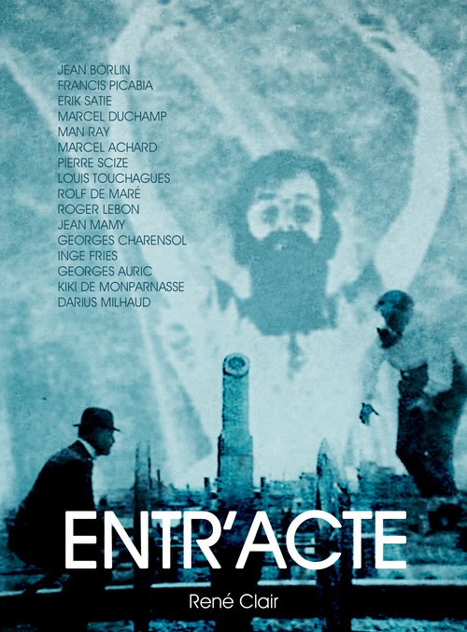
o nadrealističkom filmu pogledati na:
https://www.youtube.com/watch?v=369IEhNjVXM
i pročitati na:
https://filmska.lzmk.hr/natuknica.aspx?id=3665
Rene Kler Međučin (Entr’acte), 1924
Film dostupan na: https://www.youtube.com/watch?v=2kGOIysVl8I

Slide 3
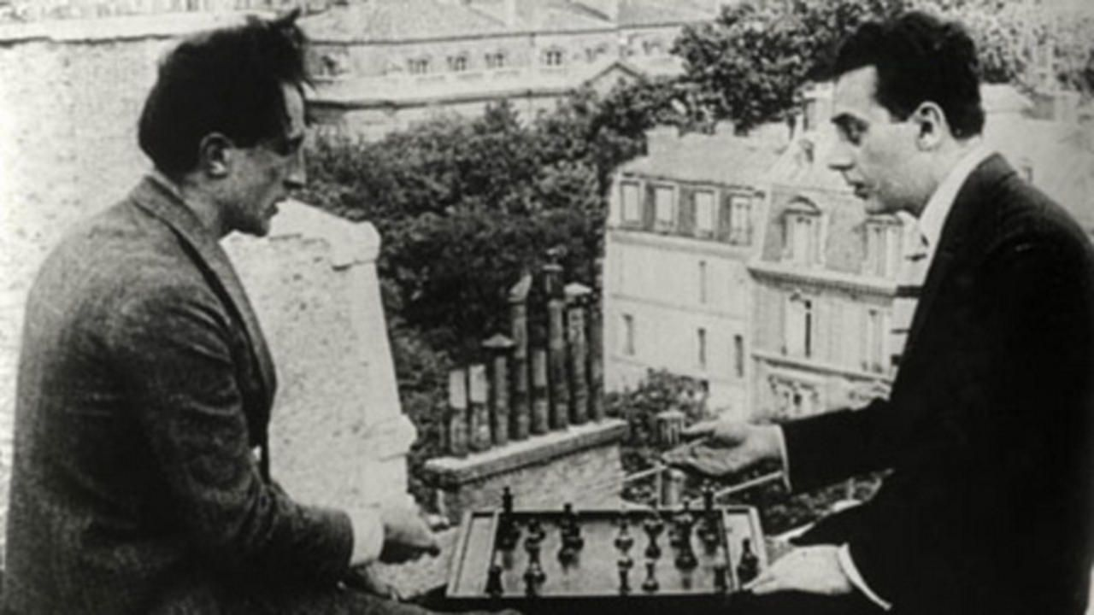
Marsel Dišan i Man Rej, kadar iz filma Rene Klera Međučin (Entr’acte), 1924

Slide 4
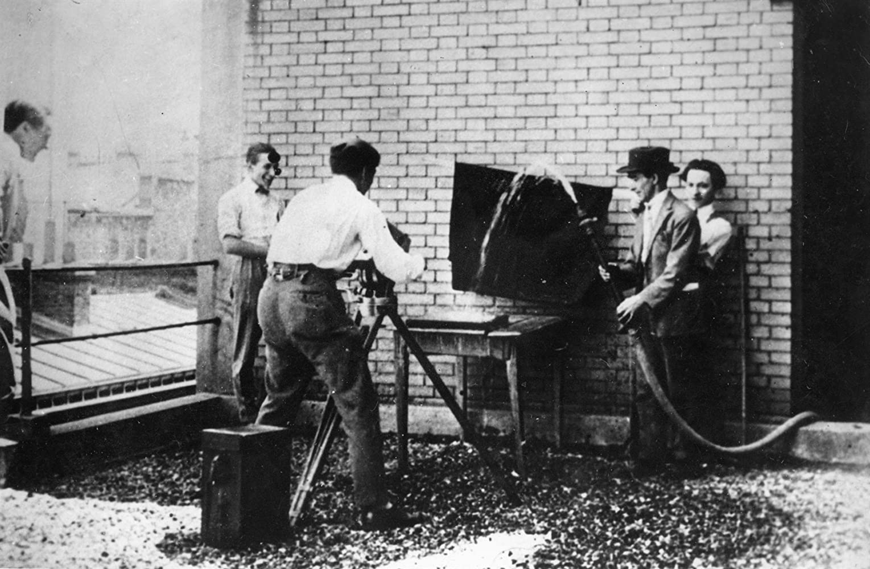
kadar iz filma Rene Klera Međučin (Entr’acte), 1924

Slide 5
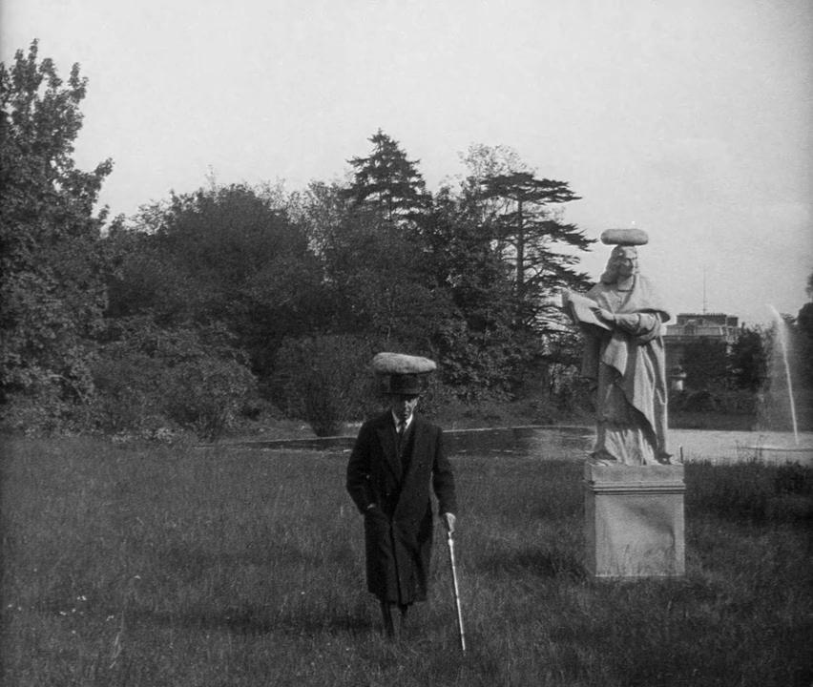
Zlatno doba (L'Age d'Or), 1930, režija: Luis Bunjuel, scenario: Luis Bunjuel i Salvador Dali
film dostupan na: https://www.dailymotion.com/video/x2164hu

Slide 6
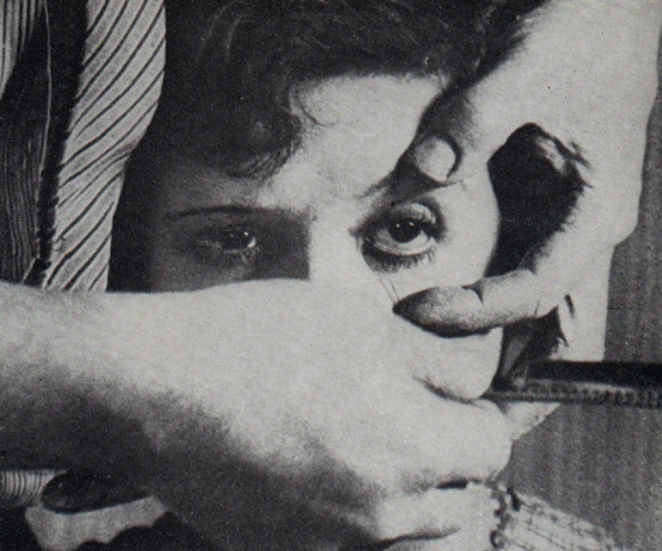
Luis Bunuel, 1928, Andaluzijski pas, scenario Dali
Film dostupan na: https://archive.org/details/LuisBunuelUnChienAndalou1928YouTube

Slide 8
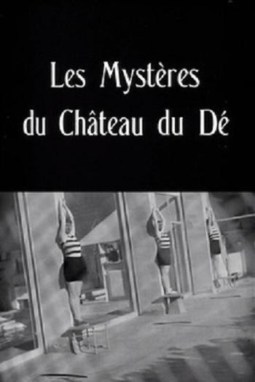
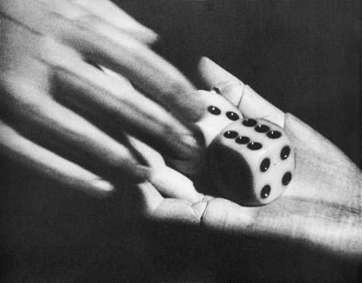
Man Ray (1929) – Misterije dvorca Kocke ("Les Mystères du Château du Dé" [The Mysteries of the Chateau of Dice]
dostupan na: https://www.youtube.com/watch?v=V6bSygUuU9o

Slide 9
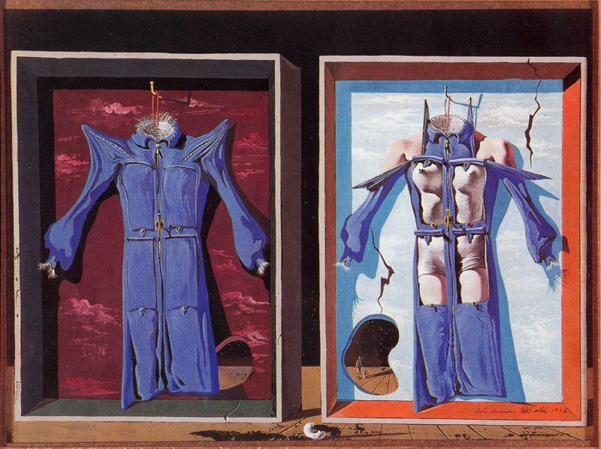
SALVADOR DALI,
Night and Day Clothes, 1936

Slide 10
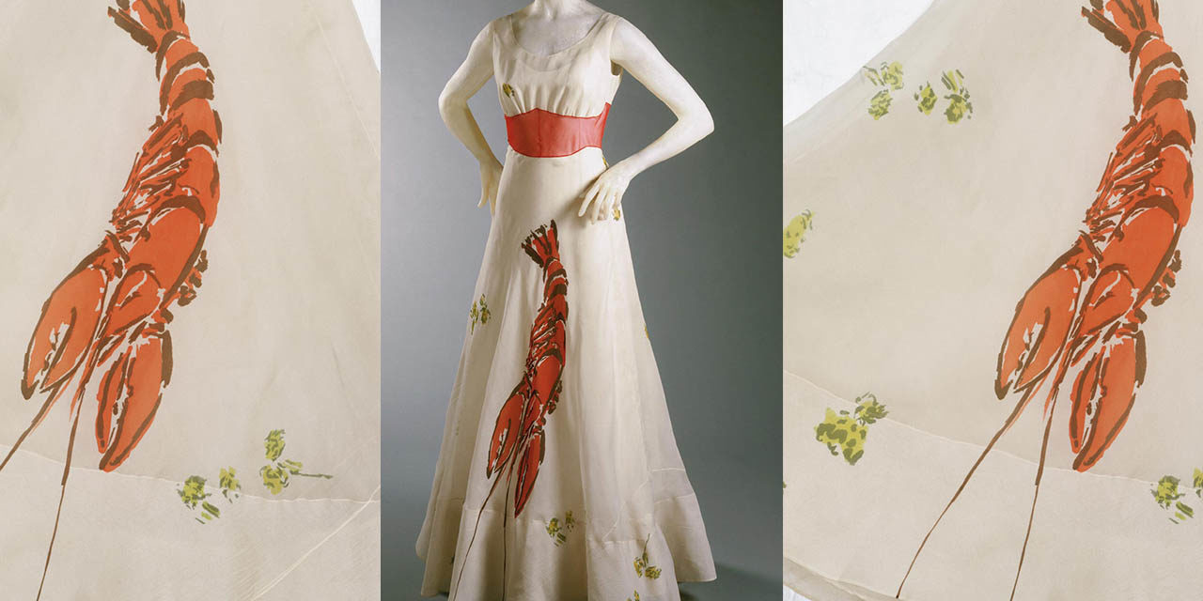
1937 – ELSA SCHIAPARELLI&SALVADOR DALI, LOBSTER DINNER DRESS

Slide 11
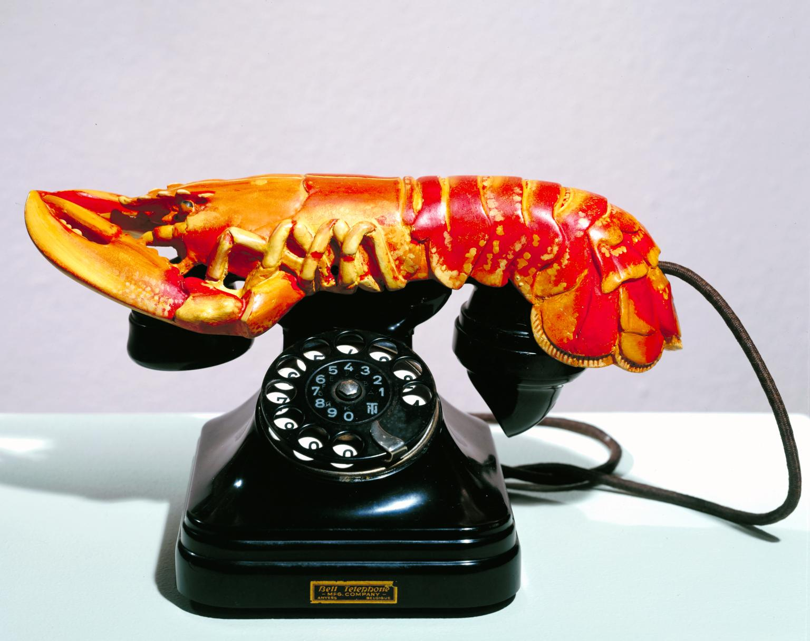
Salvador Dali, Lobster Telephone, 1936
Videti na: https://www.tate.org.uk/art/artworks/dali-lobster-telephone-t03257

Slide 12
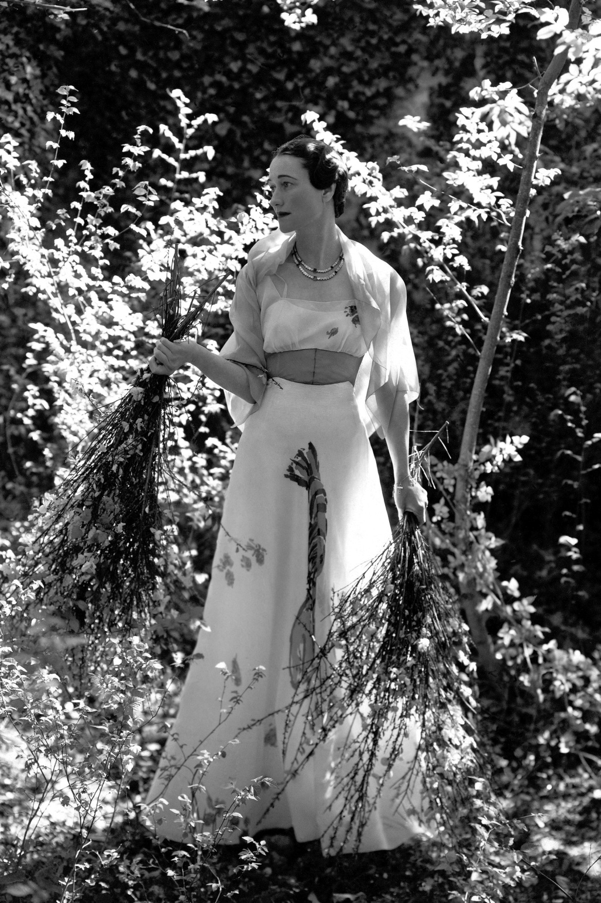
Wallis Simpson, 1937 "The Future Duchess of Windsor". Vogue (NY), Vol. 89, Iss. 11, (Jun 1, 1937): 54. , photo: Cecil Beaton

Slide 13
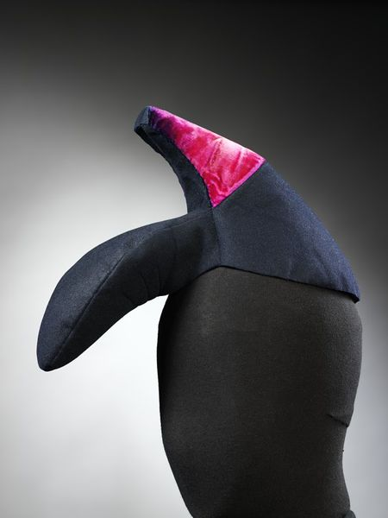
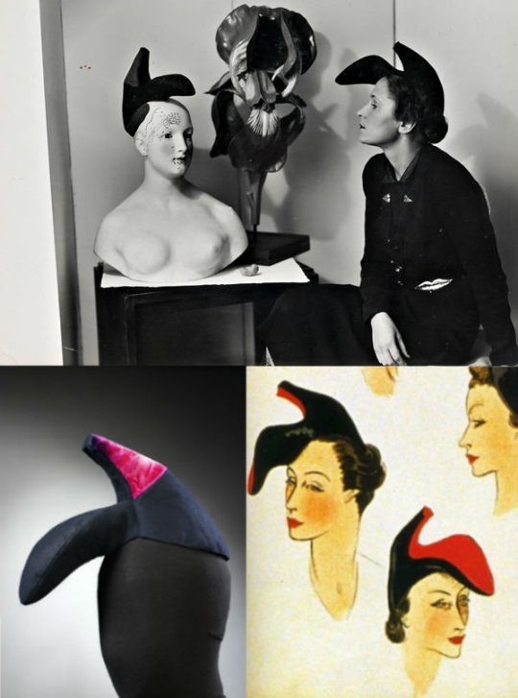
Elsa Schiaparelli, Shoe Hat, 1938-39 (prema crtežu S. Dalija)

Slide 14
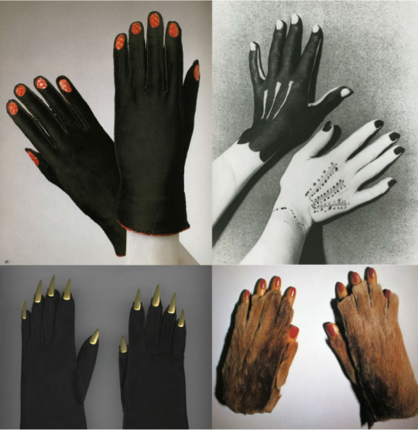
Skjapareli, Zimske ženske rukavice (zima 1936/37, gore levo).
Skjapareli, Rukavice (oko 1936, dole levo).
Ruke koje je islikao Pikaso, foto: Man Rej (1935, gore desno).
Meret Openhajm, Krznene rukavice sa drvenim prstima (1936, dole desno).

Slide 15
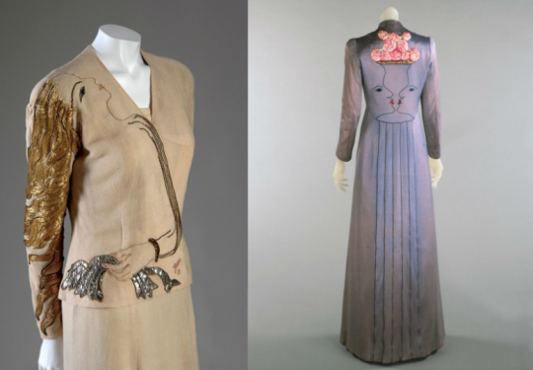
Skjapareli, Večernje toalete u saradnji sa Žanom Koktoom (jesen 1937)

Slide 16
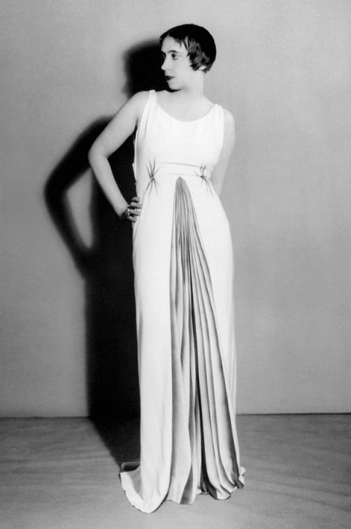
Elsa Schiaparelli in an evening dress of her own design, with painted details by Jean Dunand, photography by Man Ray, 1934

Slide 17
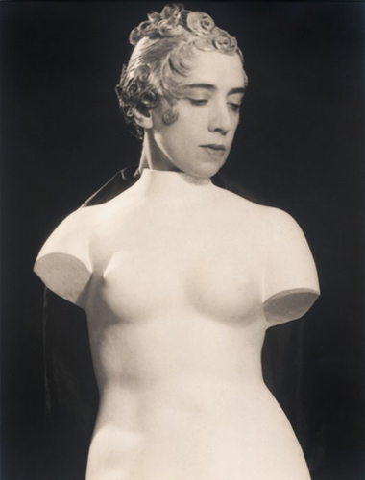
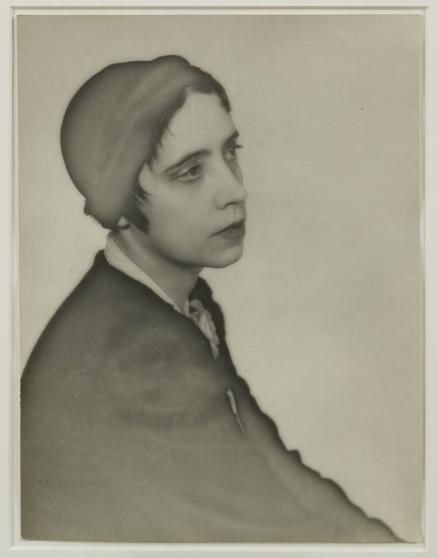
MAN RAY Elsa Schiaparelli, 1933
MAN RAY Elsa Schiaparelli, jesen 1932

