Slide 1
bauhaus-nastavak

Slide 2
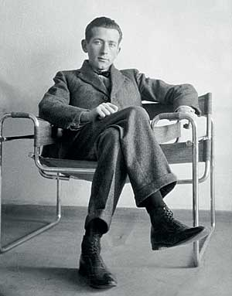
Marsel Brojer (Marcel Breuer (1902 –1981))
U decembru 1922. se grupa studenata među kojima je bio i Brojer distancirala od ekspresionizma manifestom KURI: ‘konstruktivno, utilitarno, racionalno, internacionalno’

Slide 3
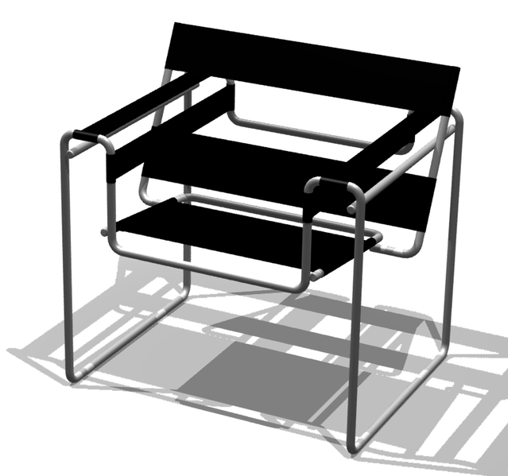
M. Breuer, Stolica Wassily (Model B3 ),

Slide 4
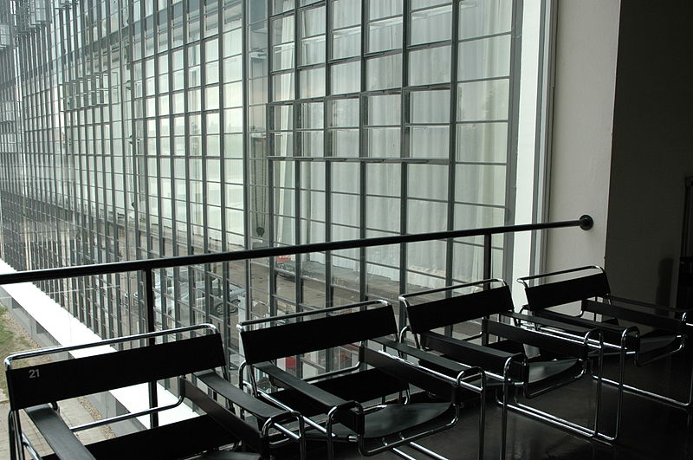
Stolica Wassily u zgradi Bauhausa, Desau

Slide 5
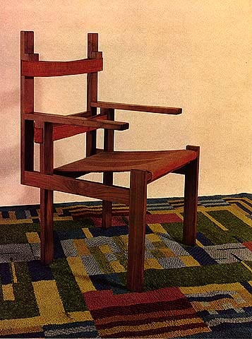
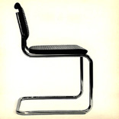
Breuer Chair
Breuer Chair

Slide 6
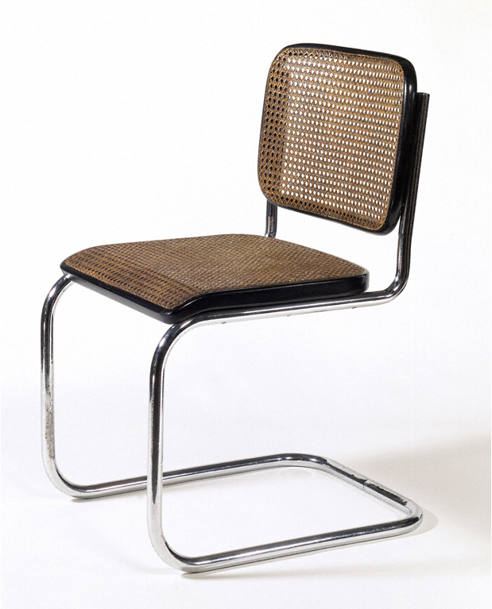
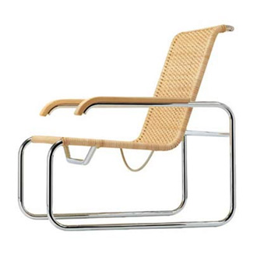
Brojer, Stolica S 35

Slide 7
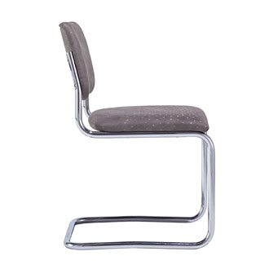
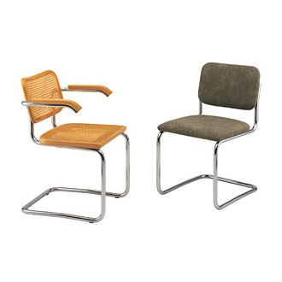
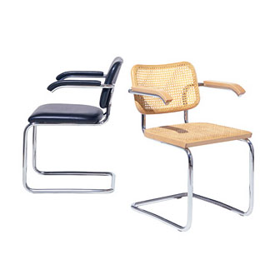
Marcel Breuer Cesca Side Chair

Slide 8
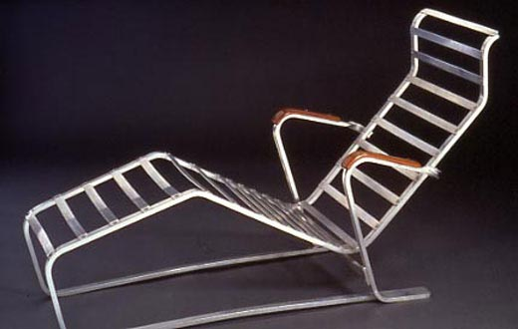
Marsel Brojer, Šezlong

Slide 9
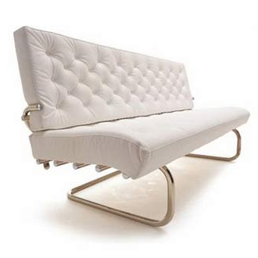
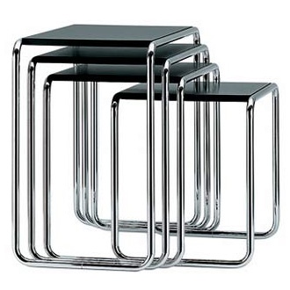
Marsel Brojer, B 9 Side Tables
Marsel Brojer, F 40 Cantilever Sofa

Slide 10
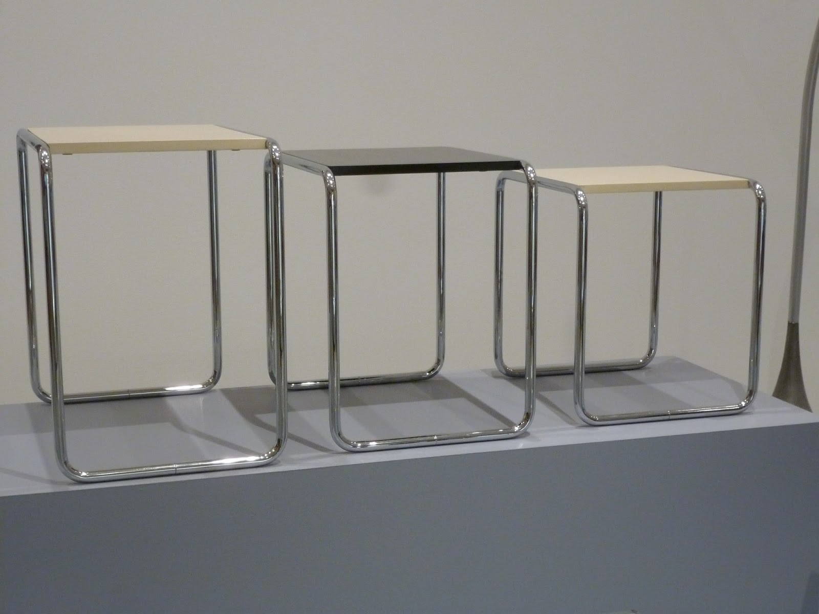
Marsel Brojer, stolovi sa tubularnim čeličnim cevima, treća decenija 20. veka, MoMA

Slide 11
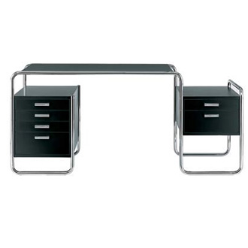
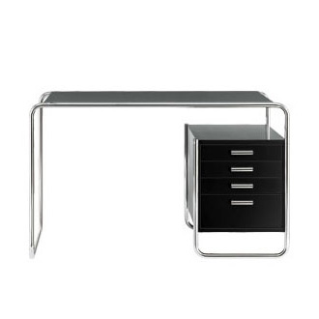
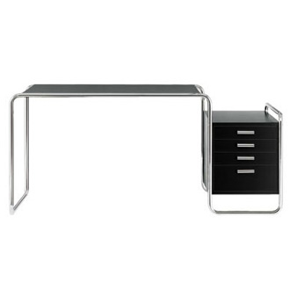
Marcel Breuer S 285 Desk

Slide 12
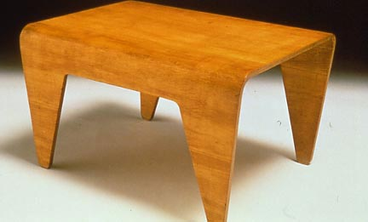
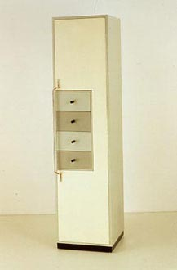
Marsel Brojer, Trpezarijski sto
Marsel Brojer, Kredenac

Slide 13
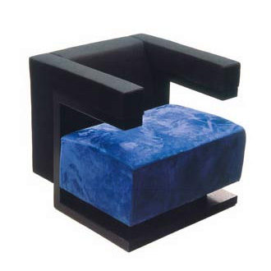
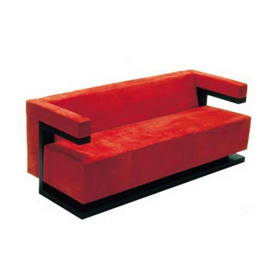
Walter Gropius, Fotelja i sofa F 51

Slide 14
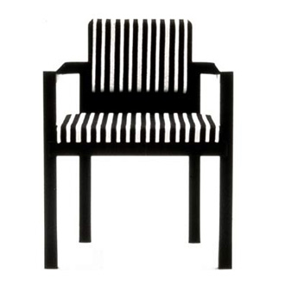
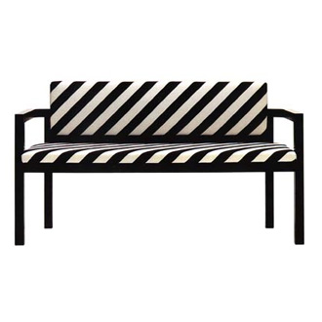
Walter Gropius Fotelja i sofa D 51

Slide 15
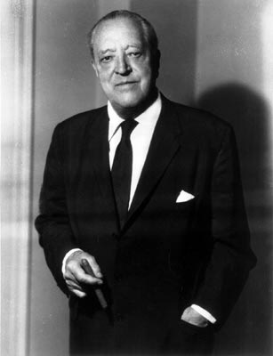
Ludwig Mies van der Rohe (1886 –1969)

Slide 16
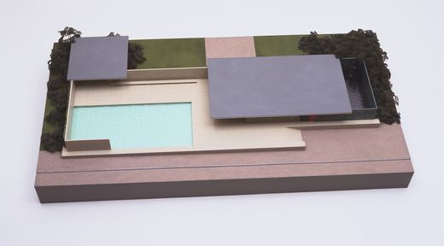
1928-29, Nemački paviljon, Svetska izložba, Barselona

Slide 17
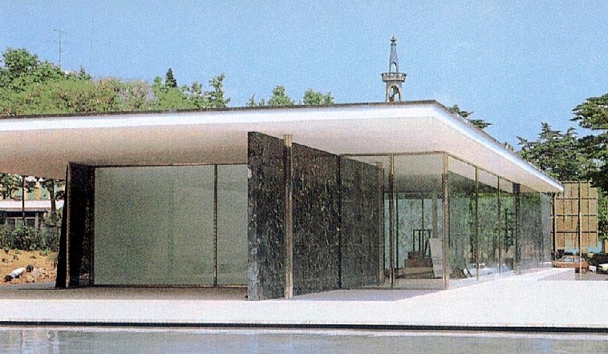
1928-29, Nemački paviljon, Svetska izložba, Barselona

Slide 18
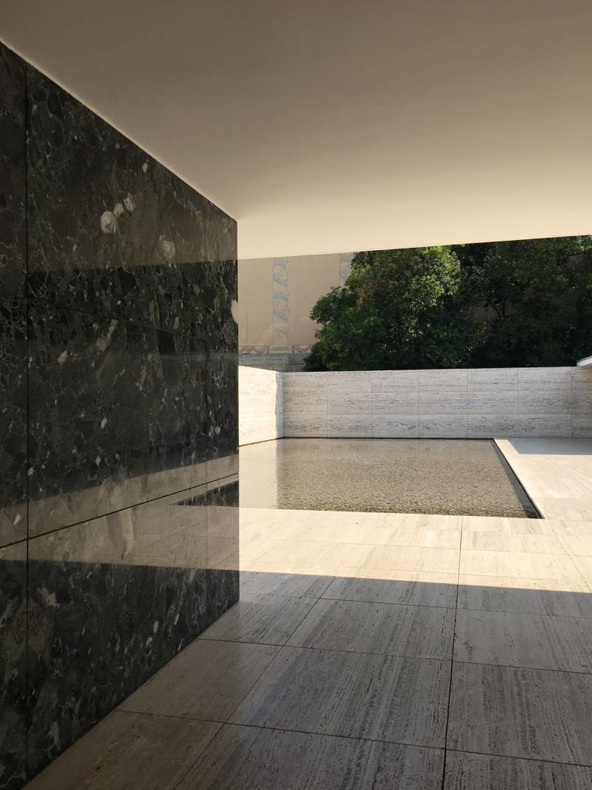
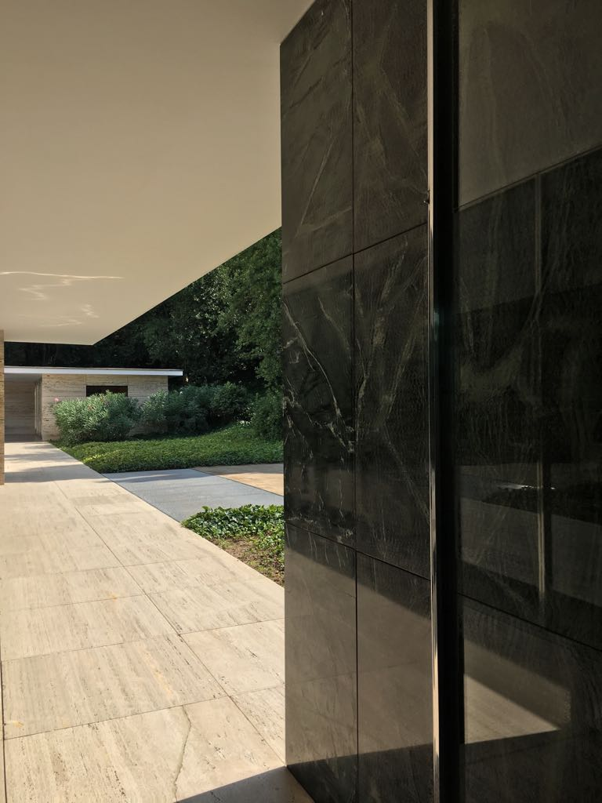

Slide 19
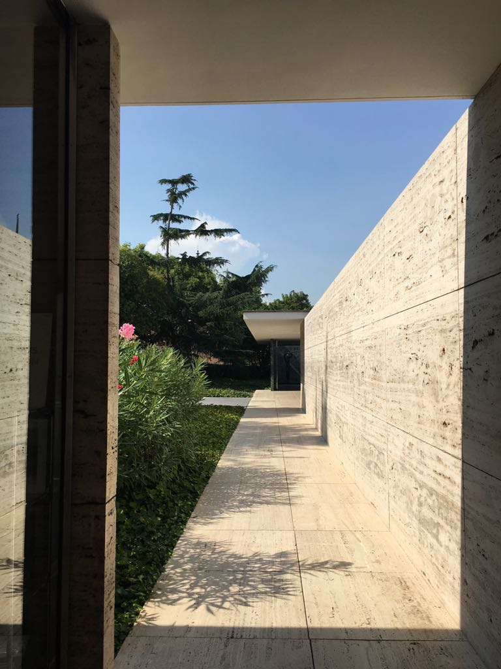

Slide 20
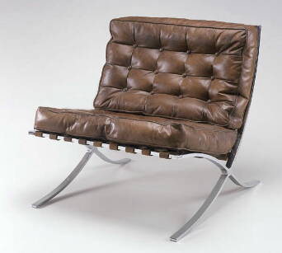
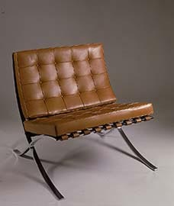
Van der Rohe, stolica Barselona

Slide 21
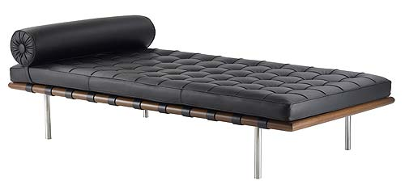
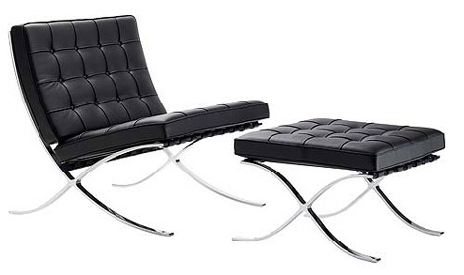
Barcelona couch and chair
(Barcelona pavillion, 1928-29)

Slide 22
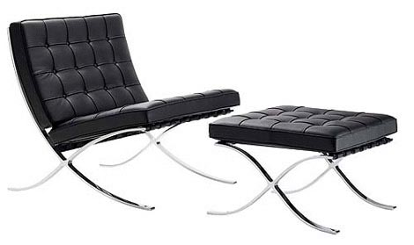
Van der Rohe, Chair

Slide 23
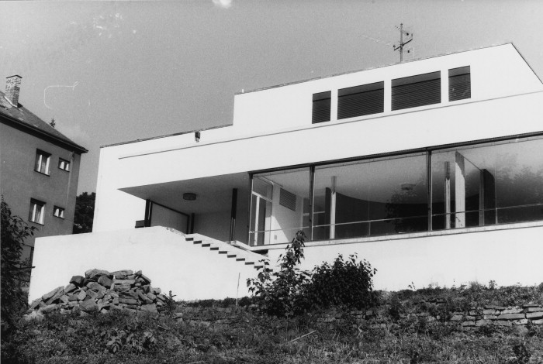
Van der Rohe , 1932, Kuća Tugendhat, Brno

Slide 24
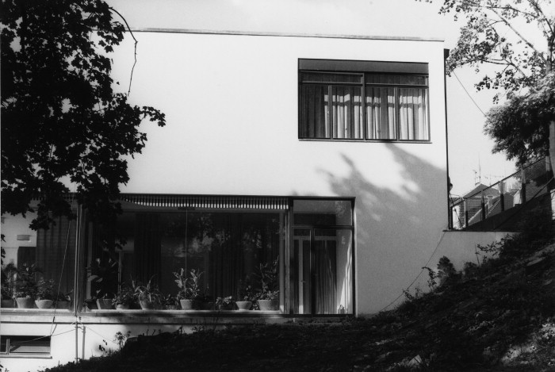
1932, Kuća Tugendhat

Slide 25
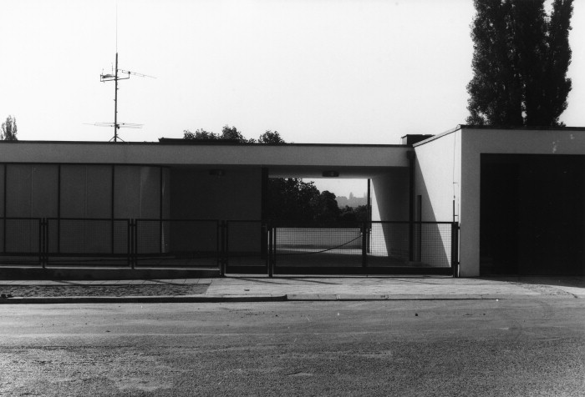
1932, Kuća Tugendhat

Slide 26
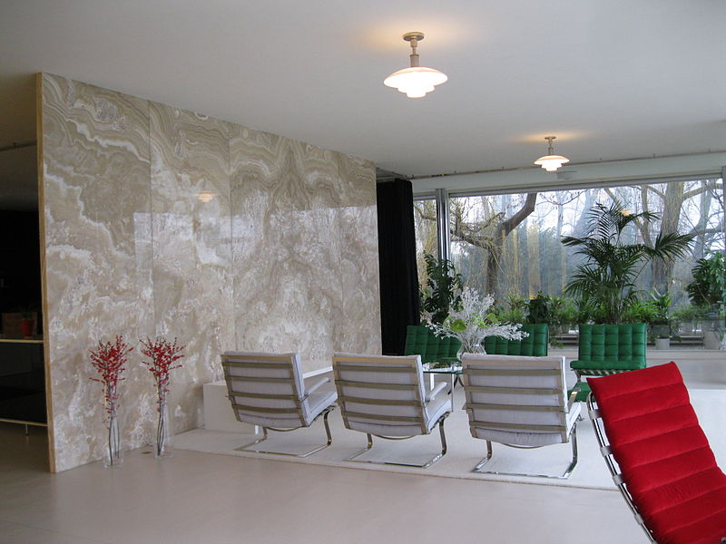
Kuća Tugendhat: dnevna soba

Slide 27
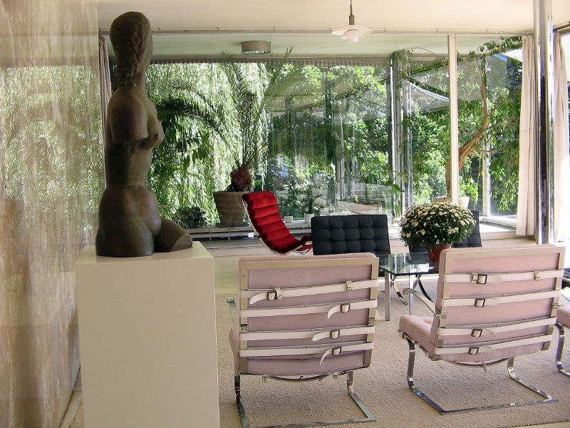

Slide 28
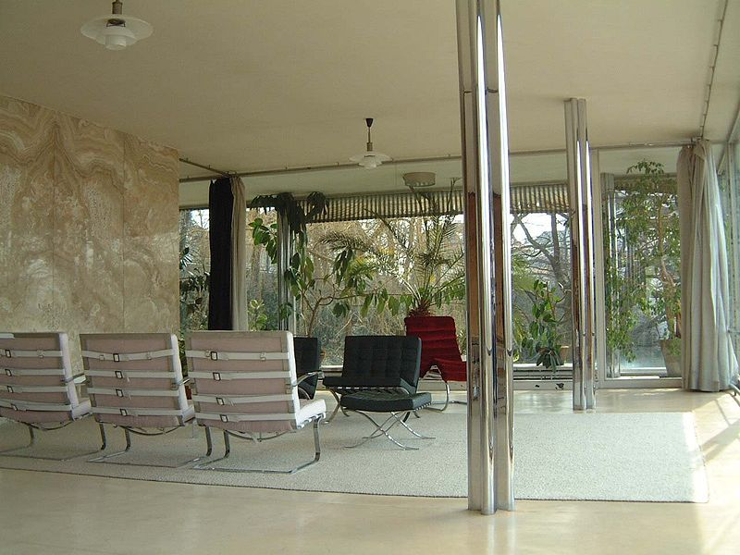

Slide 29
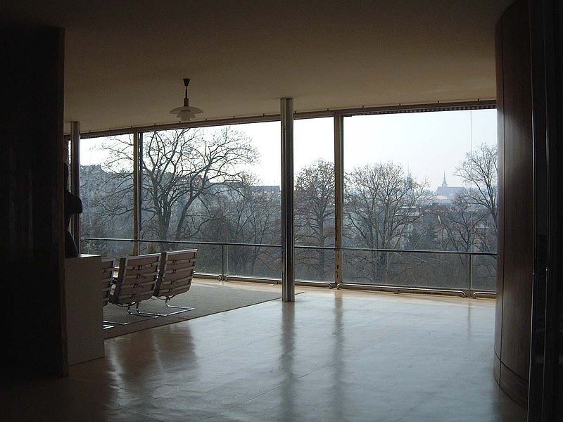

Slide 30
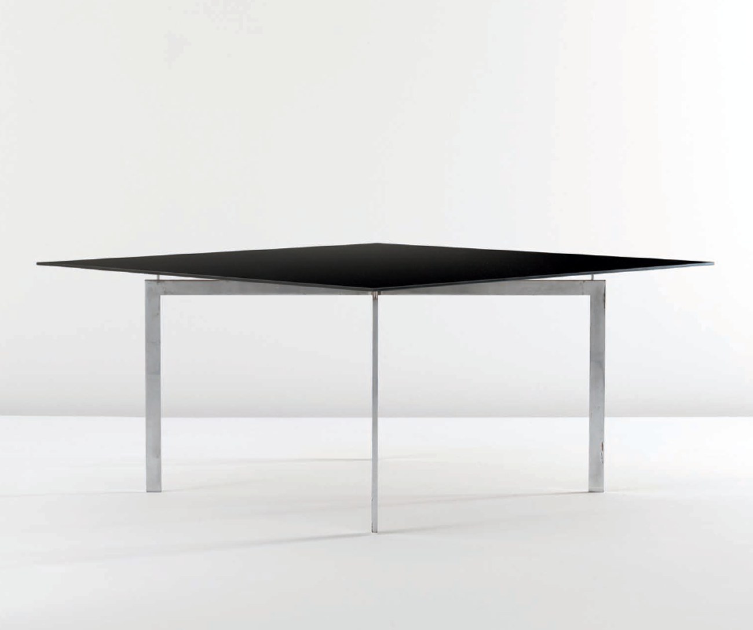
Kuća Tugendhat : sto

Slide 31
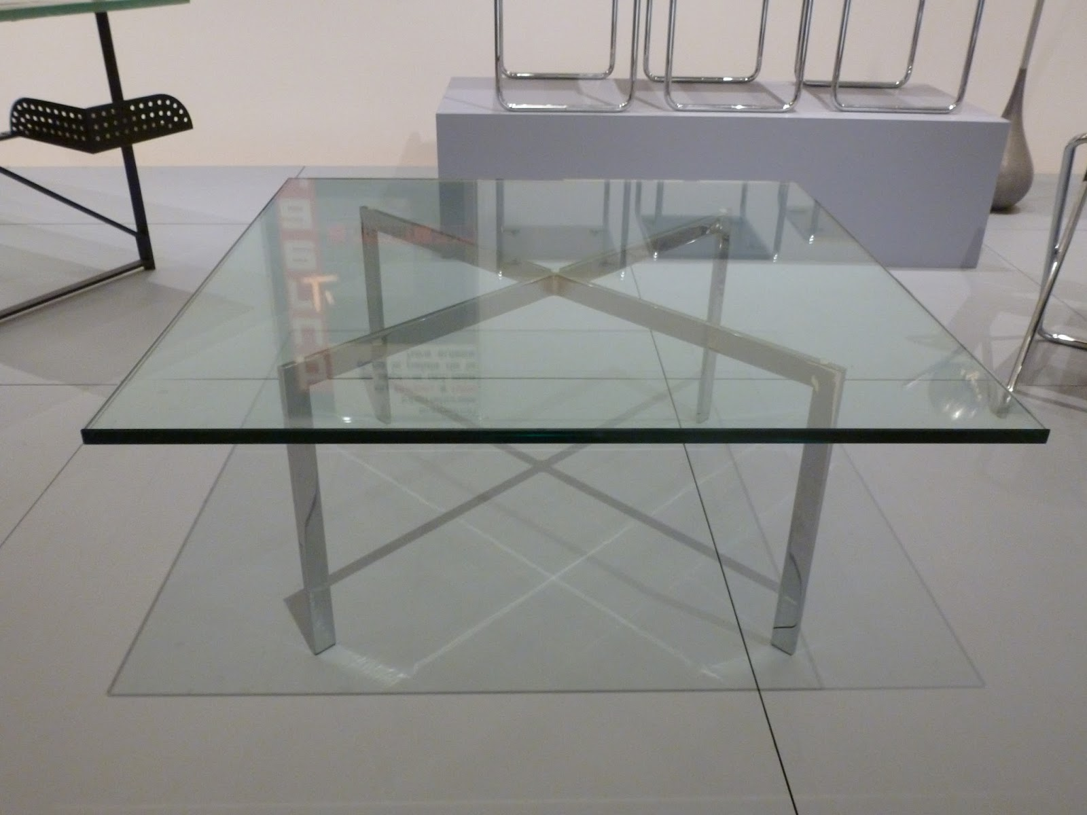
A Tugendhat table designed by architect Mies Van Der Rohe, MoMA

Slide 32
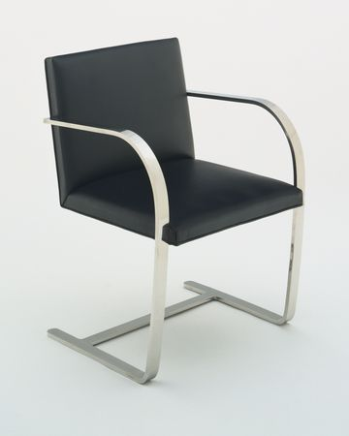
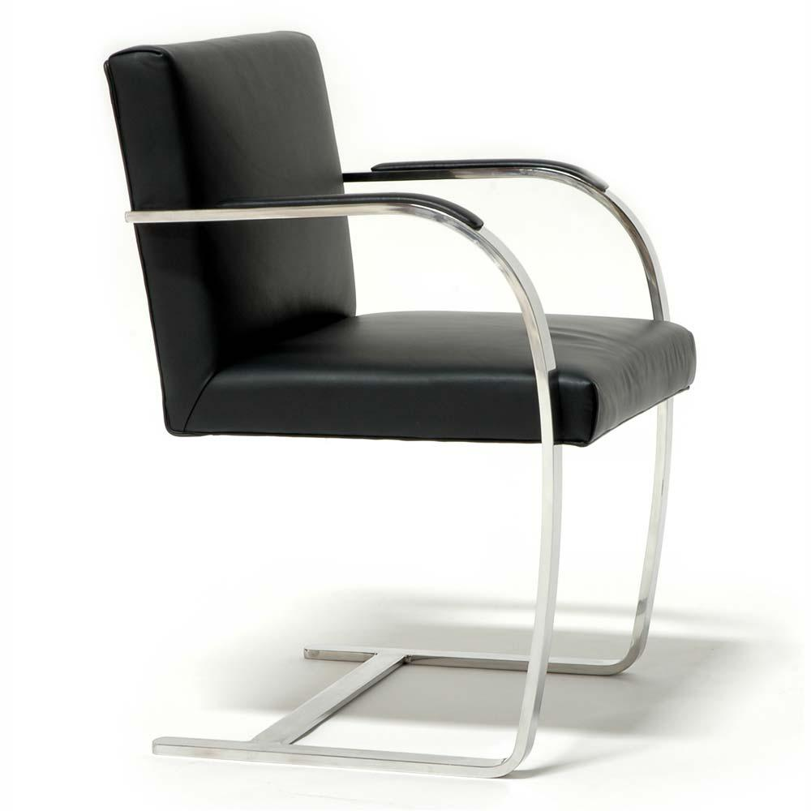
Kuća Tugendhat: (Brno) stolica

Slide 33
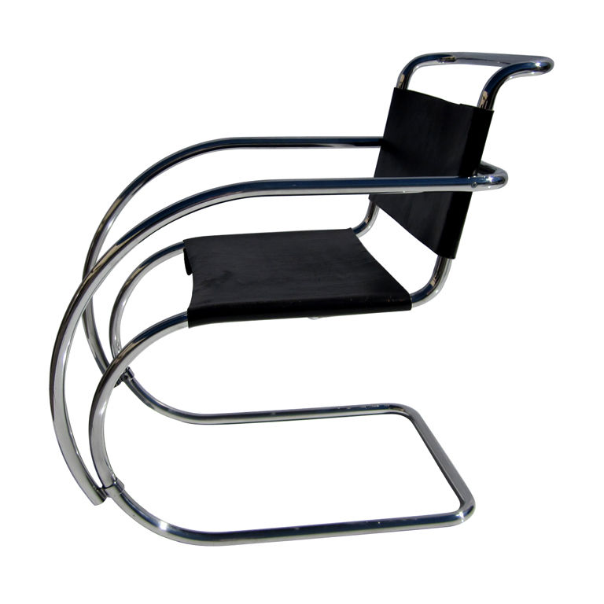
MR armchair

Slide 34
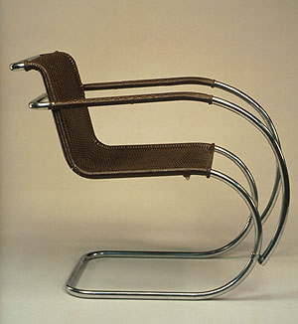
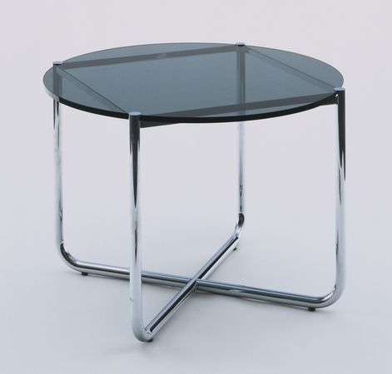
Van der Rohe 1927, MR stočić za kafu
Van der Rohe, 1927, MR fotelja
https://www.metmuseum.org/art/collection/search/482117

Slide 35
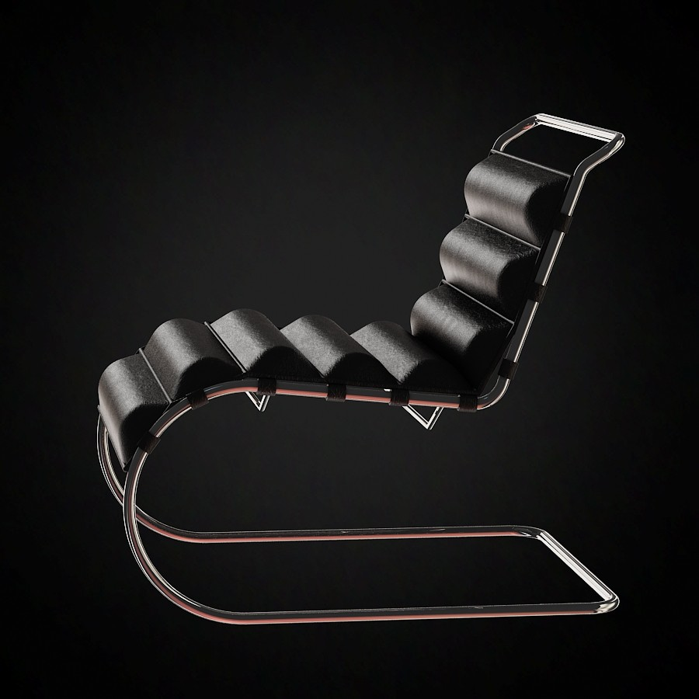
Van der Rohe, Šezlong

Slide 36
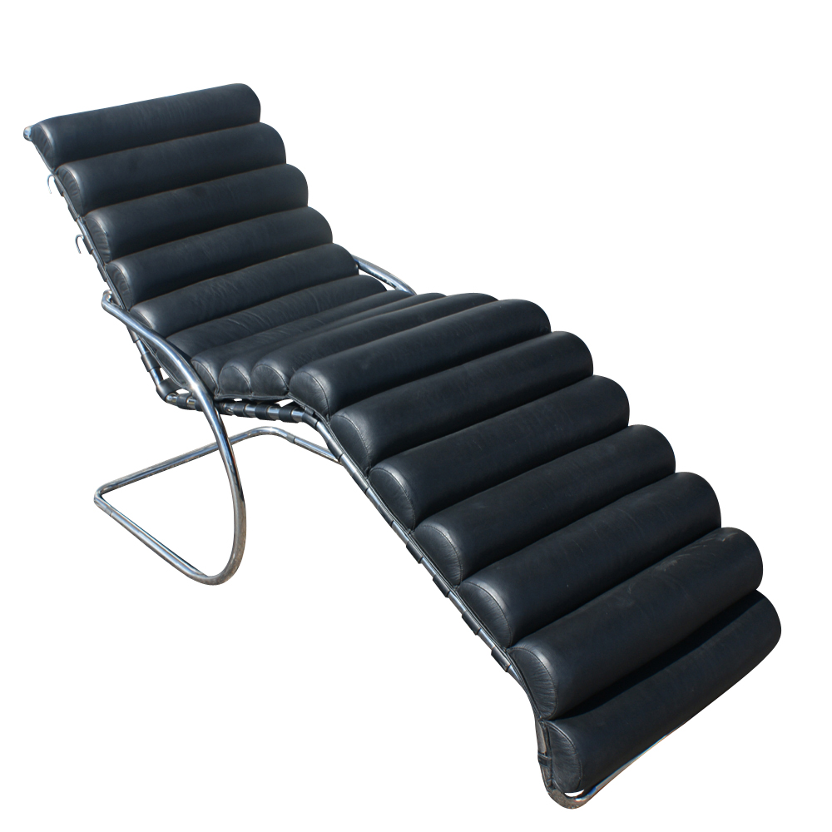
Mies Van Der Rohe, MR Šezlong

Slide 37
Hans Emil "Hannes" Meyer (1889 –1954)

Slide 38
Bauhaus Teapot, Liquor
Bauhaus Tea Set
Bauhaus Teapot

Slide 39
A 1927 tea infuser by Marianne Brandt
NEUM SLUTZKY, Cajnik

Slide 40
Marianne Brandt, pepeljare, 1920, MoMA

Slide 41
Typewriter "Olivetti Studio 42" designed by the Bauhaus-alumni Alexander Schawinsky in 1936

Slide 42
Bauhaus tkanina
Bauhaus kolevka

Slide 43
Gunta Stölzl (1897 –1983), tkanina

Slide 44
Ani Albers, Nacrt za tapiseriju, 1926

Slide 45
Ani Albers, Crno, belo, žuto' (1926/ Gunta Stölzl ponovo tkala 1965), pamuk i svila, 2032 x 1207 mm.

Slide 46
Ani Albers, studija efekta konstrukcija tkanja, nedatovano

Slide 47
Herbert Bayer (1900 –1985), Bauhaus Font
Bauhaus Font

Slide 48
Marianne Brandt desklamp
Marianne Brandt i Hans Przyrembel, Bauhaus luster, 1925.

Slide 49
Wilhelm Wagenfeld, stona lampa, treća decenija 20. veka, MoMA

Slide 50
Bauhaus rasveta od presovanog metala masovno proizvođena u periodu 1928. i 1930. kada je na mestu direktora Bauhausa bio Hanes Mejer

Slide 51
Gropius, Velika sala sa Brojerovim nameštajem, Desau, 1925-26.

Slide 52
Drawings by Herbert Bayer in the stairway of the main building of the Bauhaus Weimar. Made for the first Bauhaus Exhibition in 1923.

Slide 53
Drawings by Herbert Bayer in the stairway of the main building of the Bauhaus Weimar. Made for the first Bauhaus Exhibition in 1923.

Slide 54
Apartman Lasla Moholji-Nađa u kampusu u Desau, 1927 (Wagenfeldova lampa and Brojerov tubularni nameštaj)

