Slide 1
dada u njujorku/frensis pikabija i man rej
vežbe: utorak, 17. mart 2020

Slide 2
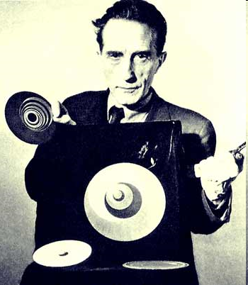
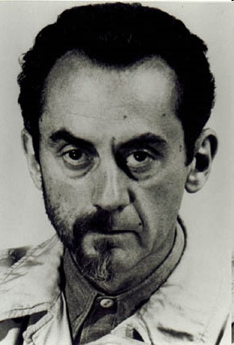
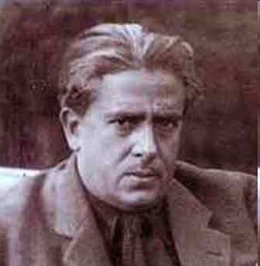
Marcel Duchamp (1889-1968)
Man Ray (1890-1976
Francis Picabia (1879-1953)

Slide 3
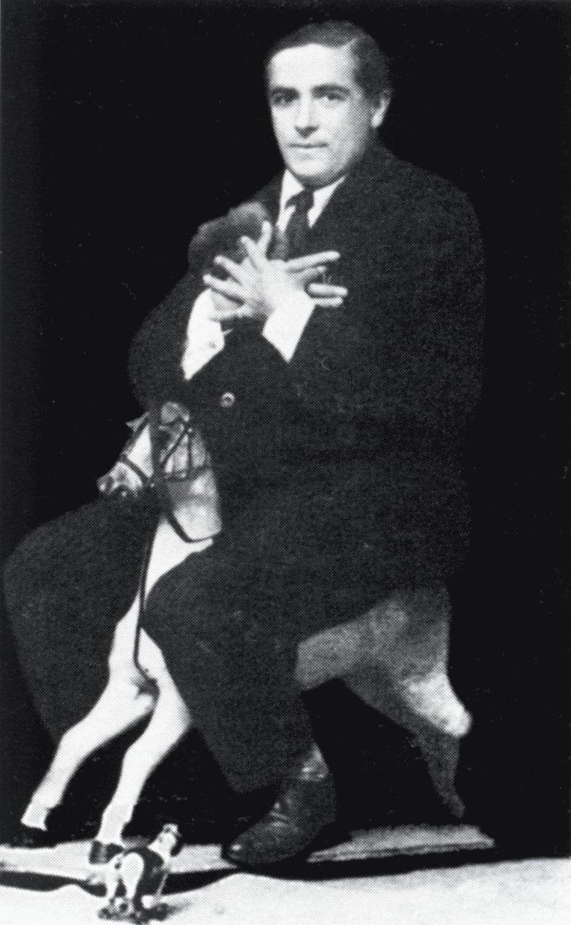
Picabia à dada (1919)
Literatura:
https://archive.org/details/francispicabia00camf/page/n5/mode/2up
M. Gale, Dada & Surrealism, Phaidon, London, 1997, 83-114; 173-212

Slide 4
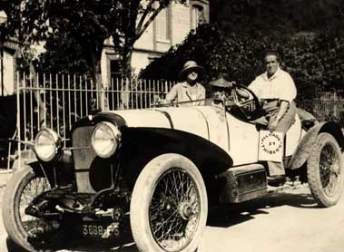
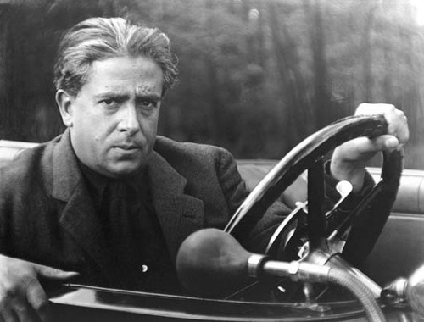
Germaine Everling, Suzanne Crotti i Francis Picabia
Picabia, foto: Man Ray (1922)

Slide 5
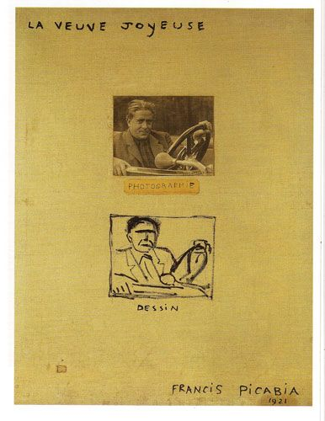
Francis Picabia, Vesela udovica (La Veuve Joyeuse), 1921 ulje, papir i fotografija na platnu, 92x73 cm

Slide 6
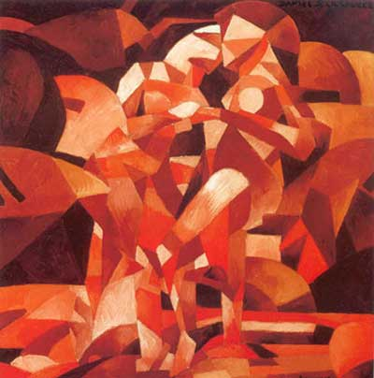
Francis Picabia Ples na izvoru (La Danse a la source), 1912 ulje na platnu, 251,8x248,9 cm, Philadelphia
Videti na https://www.philamuseum.org/collections/permanent/51073.html
Bife (Gabrièle Buffet-Picabia) imenovala saradnju Dišana, Apolinera i Pikabije pre rata ‘pre-dada’ (1912-1914)
Apoliner je u svojoj knjizi Estetske meditacije: kubistički slikari (1912) izdvojio Dišana i Pikabiju – psihološke motivacije u izboru teme vs formalizam kubista
Lirski pristup orfizam (poetski odgovor na Bergsonovu ideju flux-a)
Erotika, ‘mehanizacija’, ironija (nagoveštaj dade)
Fragmentacija i ravnoteža - sećanje

Slide 7
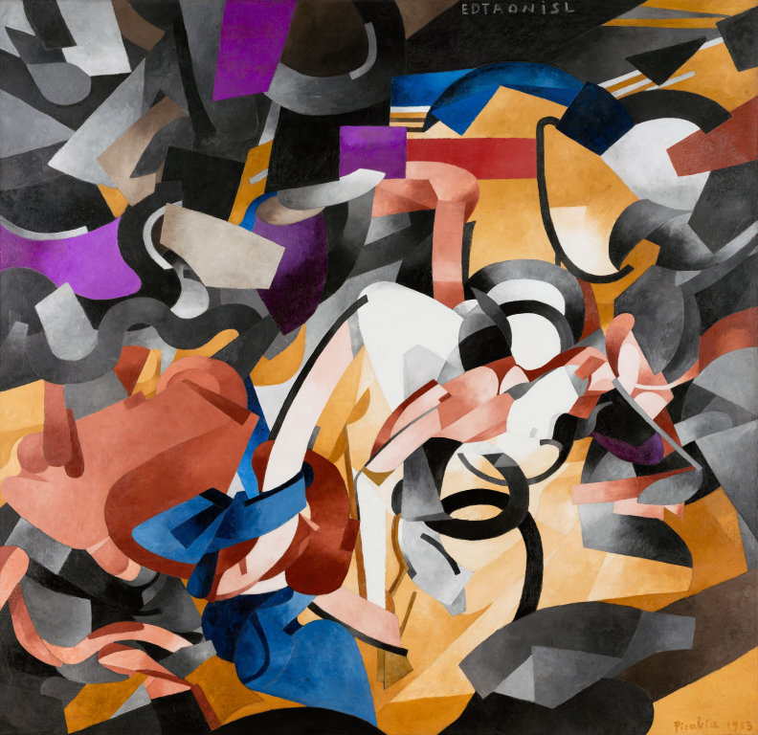
Edtaonisl (Ecclesiastic),
1913
Oil on canvas (300.4 x 300.7 cm)
Edtaonisl - akronim od slova reči etoile&danse
(Stasija Napierkovska )
Videti na: https://www.artic.edu/artworks/80062/edtaonisl-ecclesiastic

Slide 8
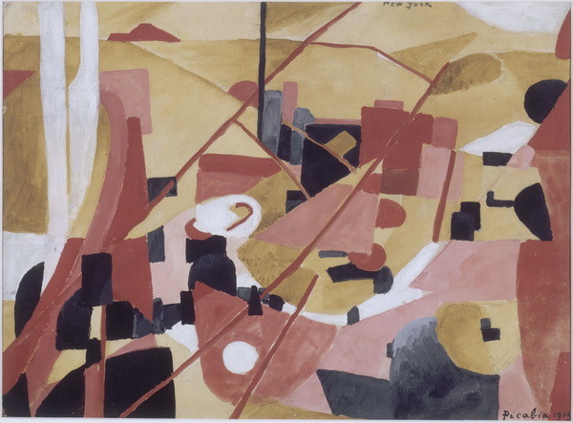
Francis PICABIA, New York, 1913, Mine graphite, gouache et aquarelle sur papier 55,8 x 75,8 cm, Le Centre Pompidou
“Vaš NY je kubistički, futuristički grad. Izražava modernu misao svojom arhitekturom, svojim životom, duhom. ... Zbog vaše ekstremne modernosti treba da brzo razumete radove koje sam napravio po dolasku u NY... Oni izražavaju duh NY kako ga ja osećam, i gužvu na vašim ulicamna kako ih ja osećam, njihov nemir, komercijalizam i njihovu šarmantnu atmosferu” Francis Picabia

Slide 9
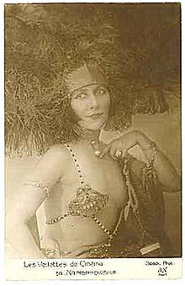
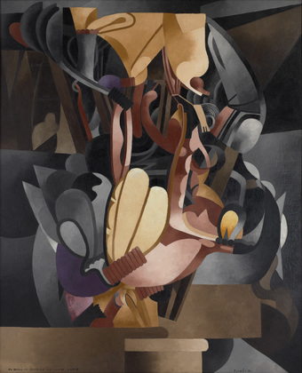
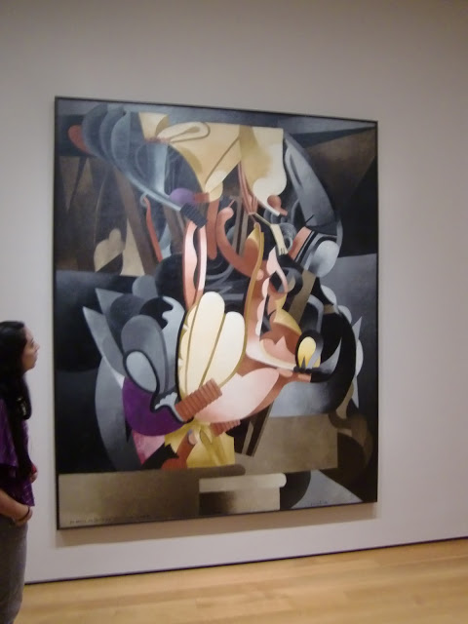
https://www.moma.org/interactives/exhibitions/2012/inventingabstraction/?work=180
Francis Picabia. I See Again in Memory My Dear Udnie. 1914,
Ulje na platnu, 250,2x198,8 cm, MoMA (svaka referenca na figurativno je rastvorena u pneumatsku formu, inspirirana susretom s Stasijom Napierkovskom ali i uspomenama na Ameriku, prolaznim utiskom, nostalgijom

Slide 10
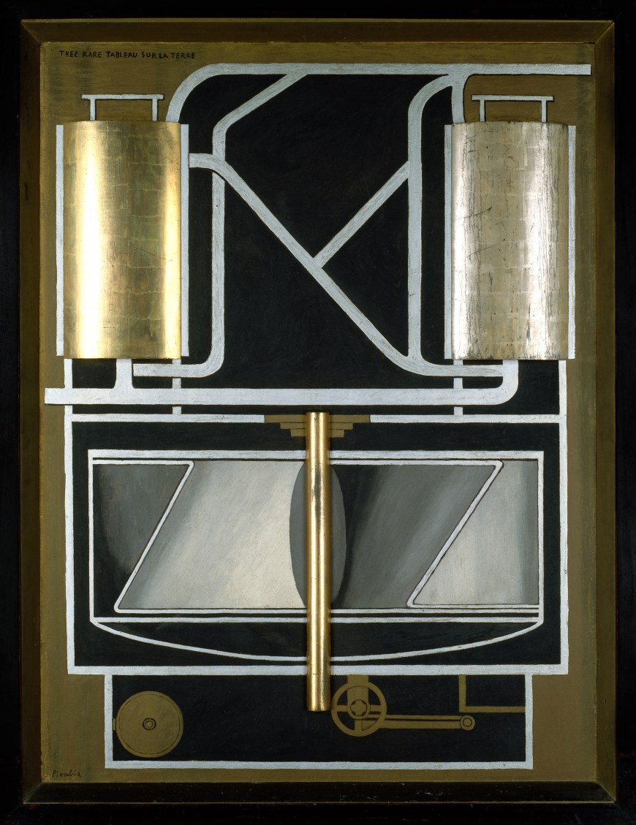
Francis Picabia. Veoma retka slika na Zemlji (Very Rare Picture on the Earth), 1915, Ulje, zlatni i srebrni listići na dasci u bojenom ramu, 125.7 x 97.8 cm)
Videti na:
https://www.guggenheim.org/artwork/3408
“mašina je postala više od puke dodatka životu, Ona je istinski deo ljudskog života..." FP

Slide 11
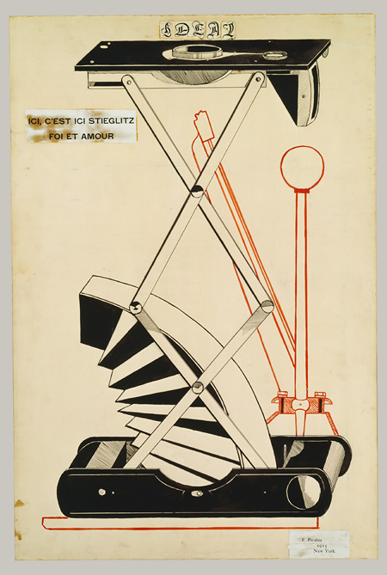
Francis Picabia, Here, This Is Stieglitz Here, 1915 Pen, brush and ink, and cut and pasted printed papers on paperboard; 75.9 x 50.8 cm, Metropolitan Museum, NY
Videti na: https://www.khanacademy.org/humanities/art-1010/wwi-dada/dada1/a/francis-picabia-ideal

Slide 12
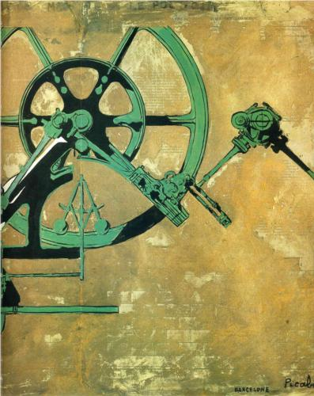
Francis Picabia, Ćerka rođena bez majke, (Fille née sans mère; Daughter Born without Mother), Gouache and metallic paint on printed paper, 1916-1917, 50.00 x 65.00 cm
Scottish National Gallery
Videti na: https://www.nationalgalleries.org/art-and-artists/8581/fille-n%C3%A9e-sans-m%C3%A8re-girl-born-without-mother

Slide 13
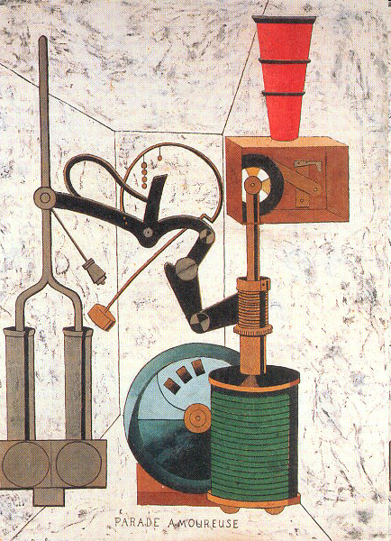
Francis Picabia, Ljubavna parada (Parade Amoureuse), 1917,
Ulje na platnu, 96,5x73,7cm, privatna kolekcija

Slide 14
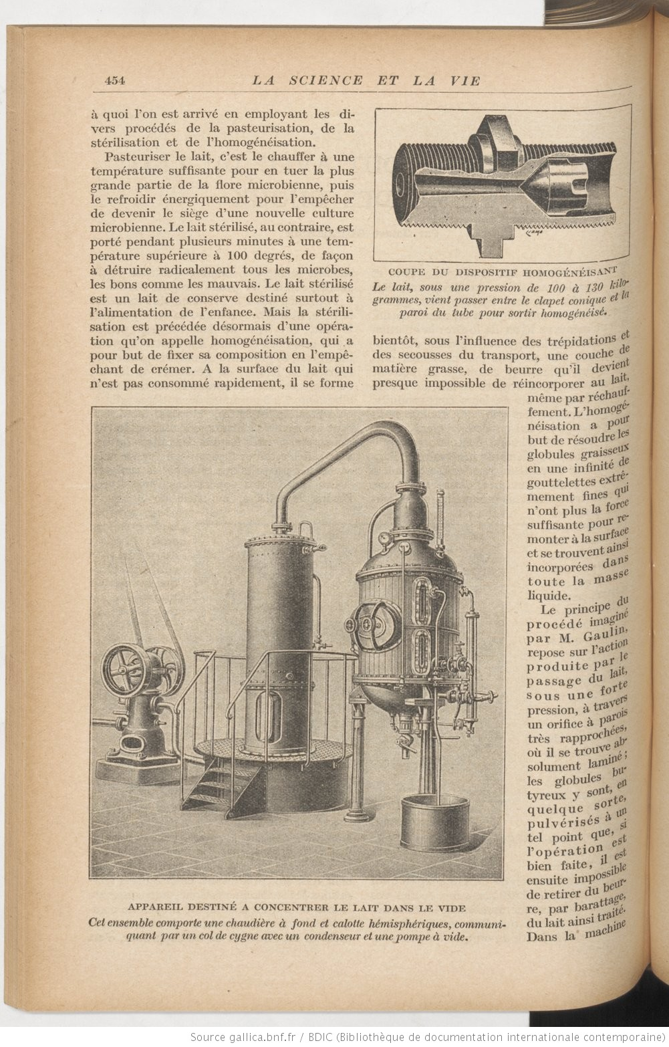
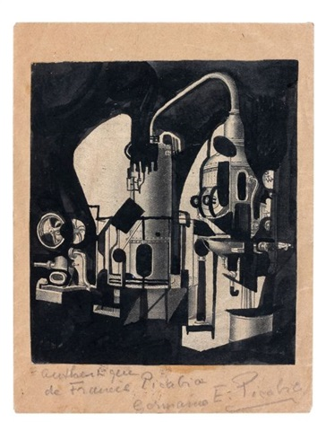
mecanique by francis picabia, 1919, mastilo
La Science et la vie, oct-nov 1919

Slide 15
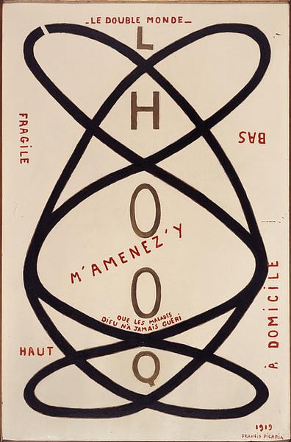
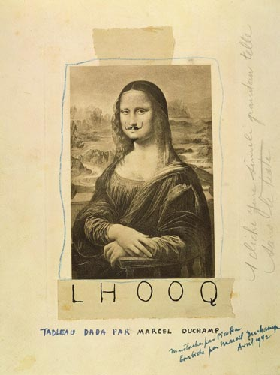
Francis Picabia, 'Le double monde', 1919,
Enamel on canvas, 132x85 cm, Centre Pompidou
https://www.toutfait.com/five-small-things-about-l-h-o-o-q/#N_3_top

Slide 16
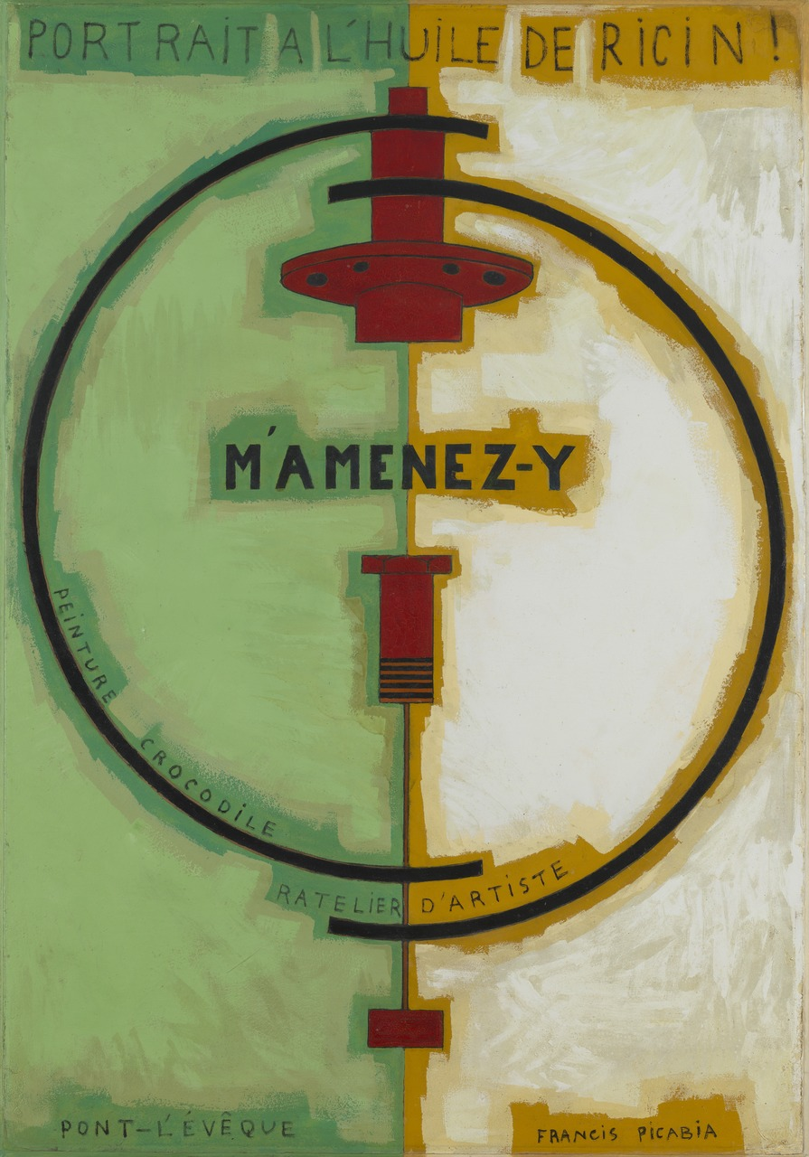
"M'Amenez-y“ (odvedi me tamo)
Paris, November 1919 - January 1920
Ulje i emajl na kartonu
(129.2 x 89.8 cm)
Videti na: https://www.moma.org/learn/moma_learning/francis-picabia-mamenez-y-1919-20/

Slide 17
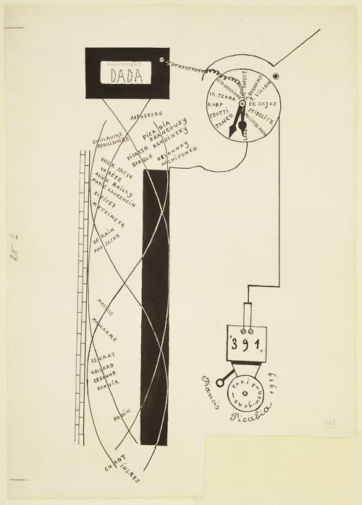
Picabia, Dada Movement, 1919, Ink on paper, 51.1 x 36.2 cm, MoMA
(Dada alarm clock;
The drawing was made for the "Anthologie Dada" issue (May 1919) of the Zurich magazine Dada, edited by Tristan Tzara )
Videti na: https://www.moma.org/collection/works/35993

Slide 18
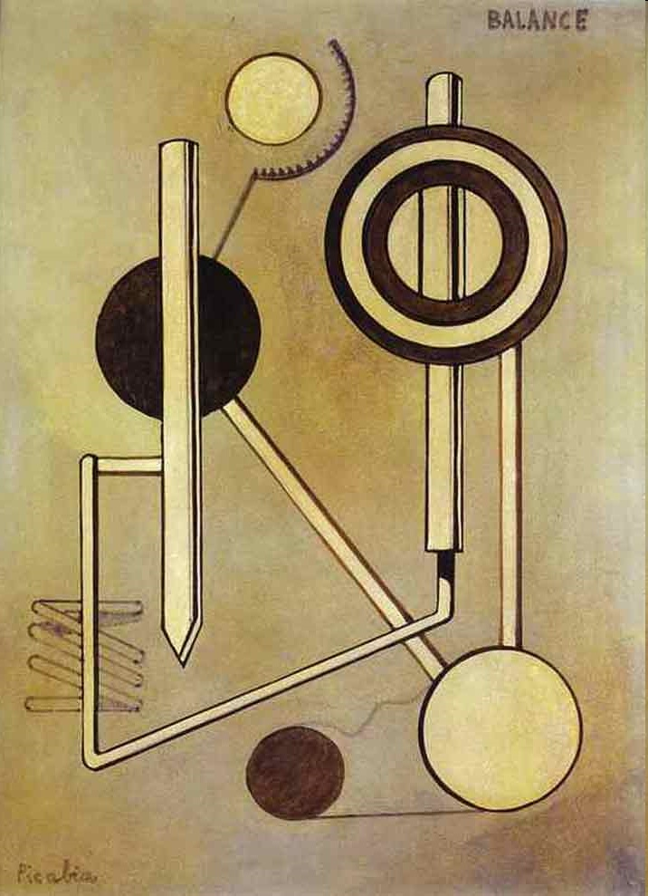
Francis Picabia, Balance, 1919, priv. coll.

Slide 19
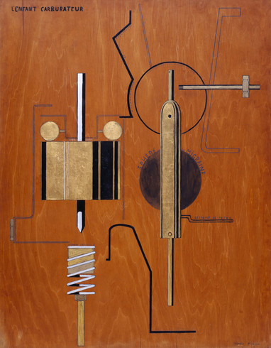
Dete karburator (The Child Carburetor ; L'Enfant carburateur), 1919. Ulje, emajl, zlatni listovi, grafit i olovka na bojenoj šperploči, 126.3 × 101.3 cm Solomon R. Guggenheim Museum, New York
Videti na: https://www.guggenheim.org/artwork/3409
Posleratna Francuska – ‘povratak redu’ uzori: Engr, klasicizam, Sera, Sezan
Dada na suprotnoj strani: umesto rekonstrukcije – haos; umesto tradicije – uništavanje svih prisutnih sistema; umesto nacionalnog identiteta – politički eho komunističke Internacionale, umesto visoke kulture – popularna kultura (petparačke priče, krimi romani, filmovi, jazz)
Pikabija razvija mekanomorfe u NY

Slide 20
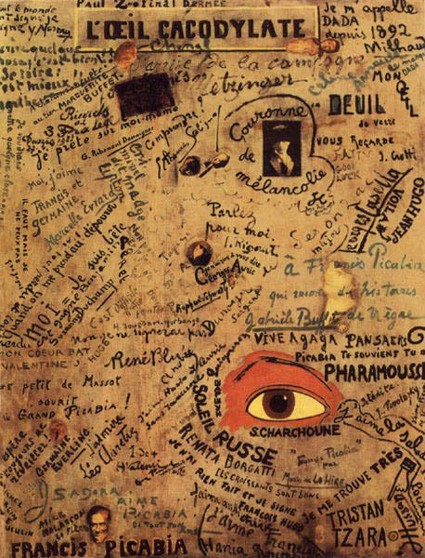
Francis Picabia, L'Oeil cacodylate, The Cacodylic Eye, 1921, Oil with photomontage and collage on canvas, 148,6x117,5 cm, Centre du Pompidou, Paris
Cacodylat – uljani, otrovni rastvor koji neprijatno miriše, i spontano sagoreva u kontaktu sa vazduhom (“hemijsko oko”, “oko koje eksplodira", “spontano oko“ ili najverovatnije, “smrdljivo oko“)

Slide 21
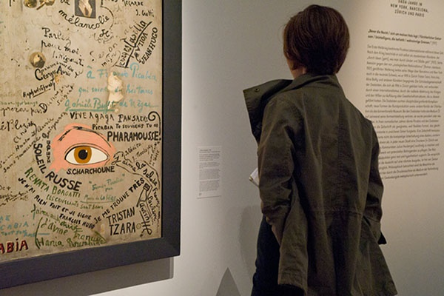

Slide 22
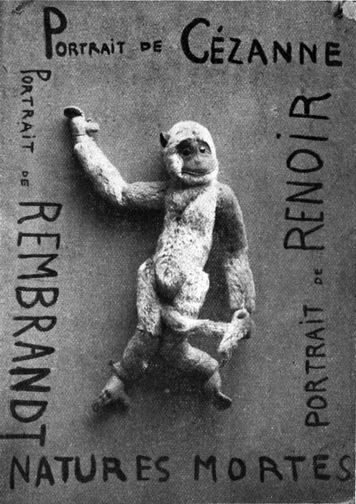
Portrait of Cézanne, Portrait of Renoir, Portrait of Rembrandt, 1920, igračka i ulje na kartonu, dimenzije i gde se danas nalazi nepoznato. Reprodukovano u časopisu Cannibale, Paris, n. 1, April 25, 1920

Slide 23
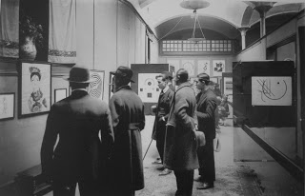
Picabia u Galeria Dalmau (1922)
Izlagao:
Minimalističke kompozicije geometrijskih formi, jednostavnih i apstraktnih
Mekanomorfe
Dela nadahnuta radiofonijom i elektrikom
Kompozitna dela – mekanomorfi s realističnim prizorima
Optička dela nadahnuta savremenim naučnim istraživanjima retinalne percepcije optičkog nerva
Španski kič

Slide 24
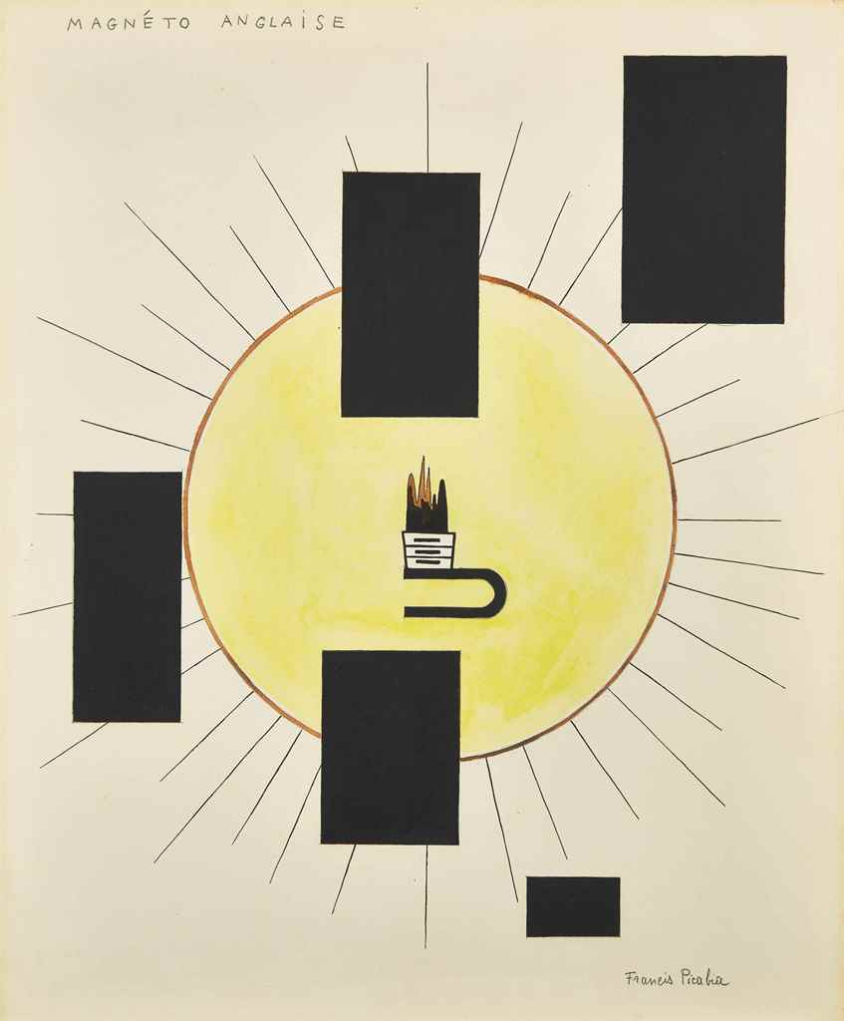
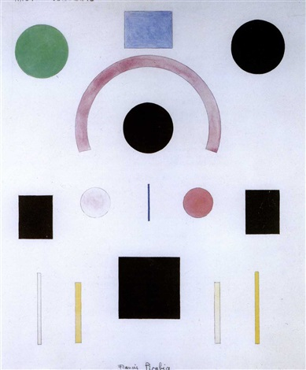
Dela nadahnuta radiofonijom i elektrikom
radio-concerts by francis picabia
Magnéto anglaise (1921-22)

Slide 25
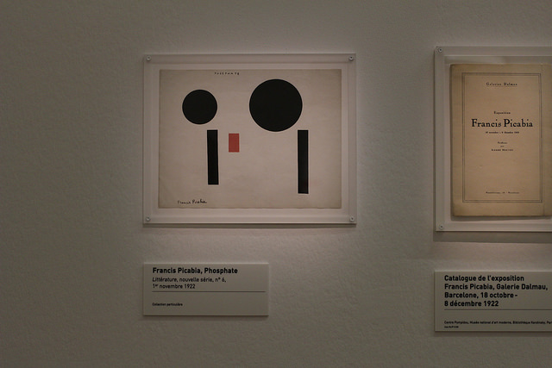

Slide 26
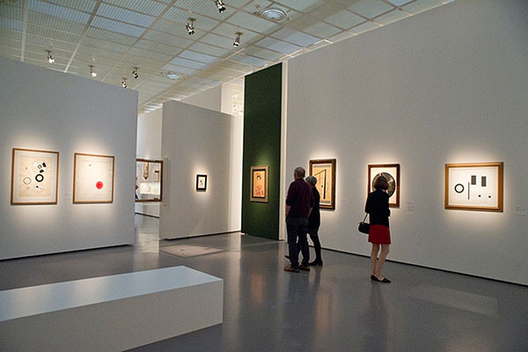

Slide 27
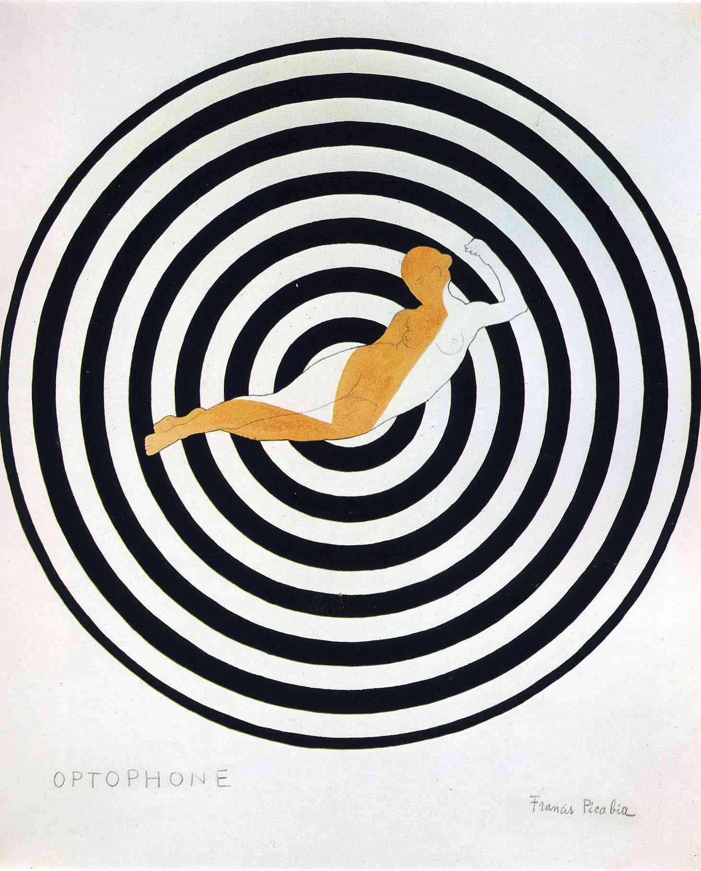
Optophone I, 1922

Slide 28
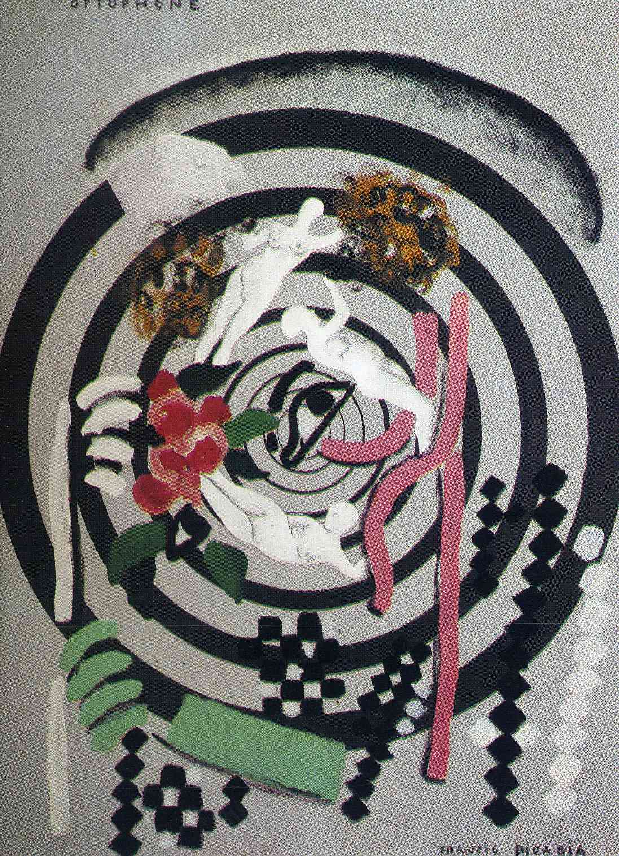
Optophone II, 1922-3, oil on canvas, 116 x 88 cm,
Musee d’Art Moderne de la Ville de Paris

Slide 29
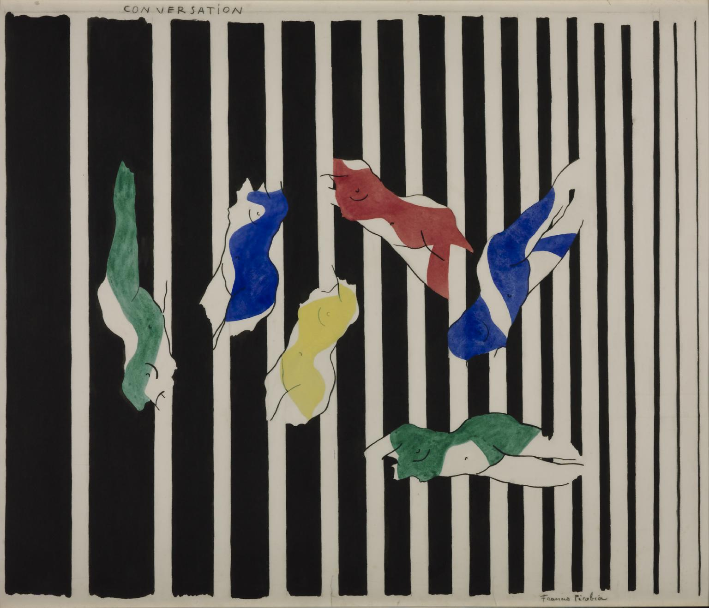

Slide 30
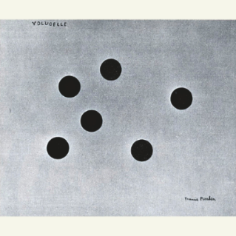
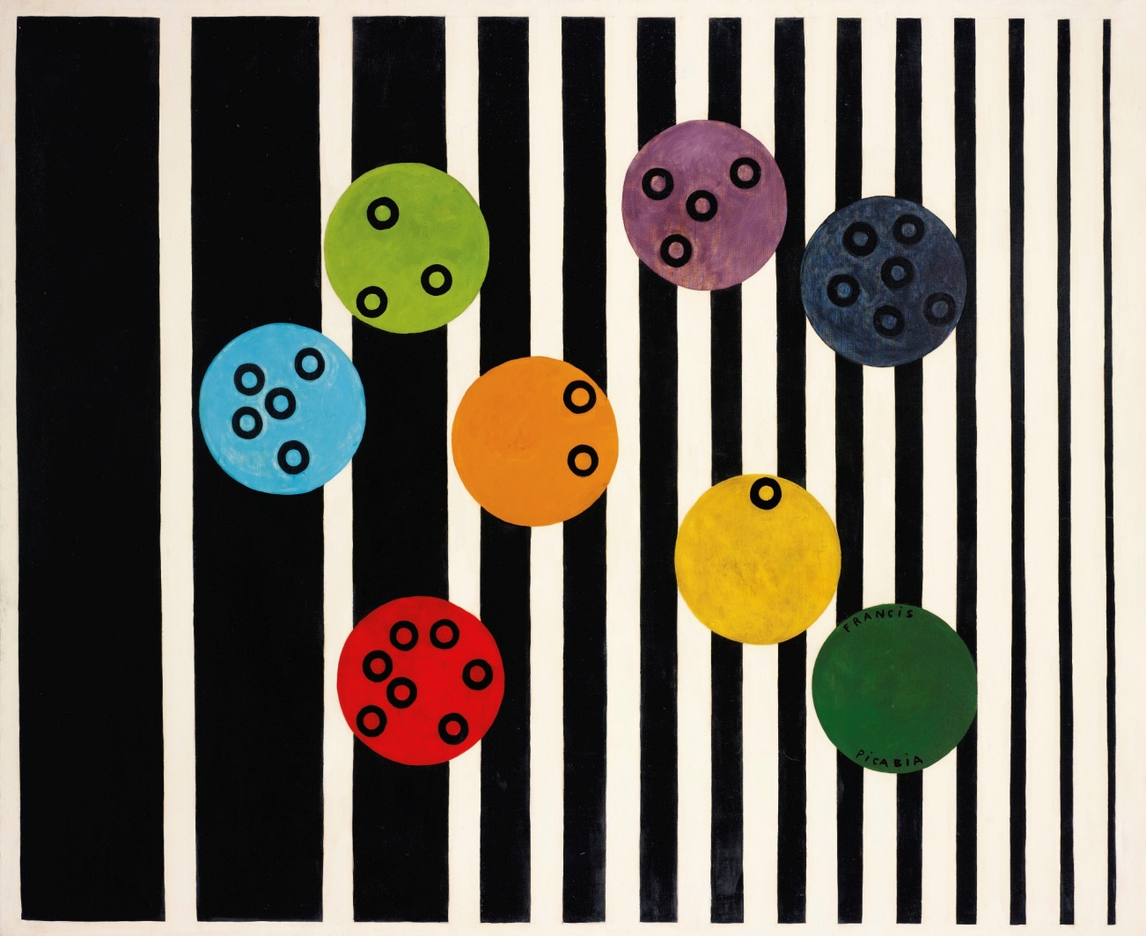
Francis Picabia, Volucelle
Francis Picabia, Volucelle II,1922

Slide 31
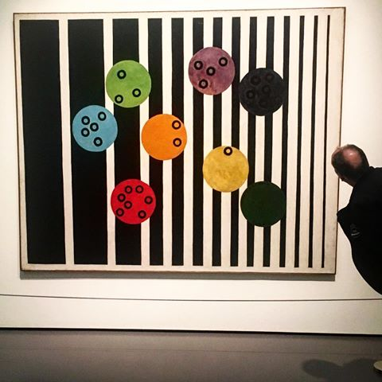

Slide 32
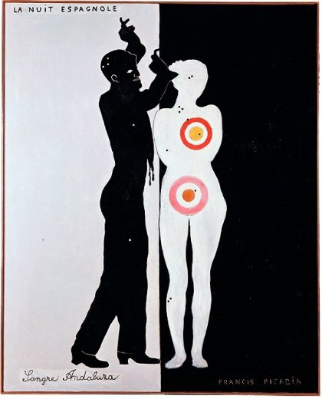
Francis Picabia, La nuit espagnole, 1922, émail sur toile, 162,5 x 131 cm, Museum Ludwig, Köln

Slide 33
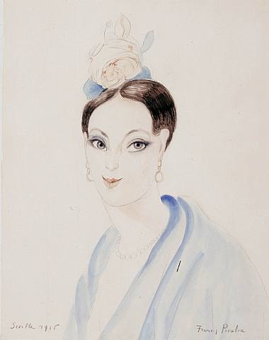
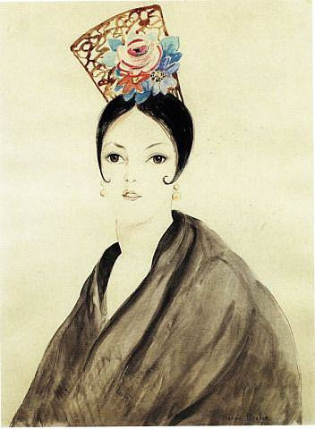
Espagnole à la rose 1916 Francis Picabia
L'espagnole (1921) Francis Picabia

Slide 34
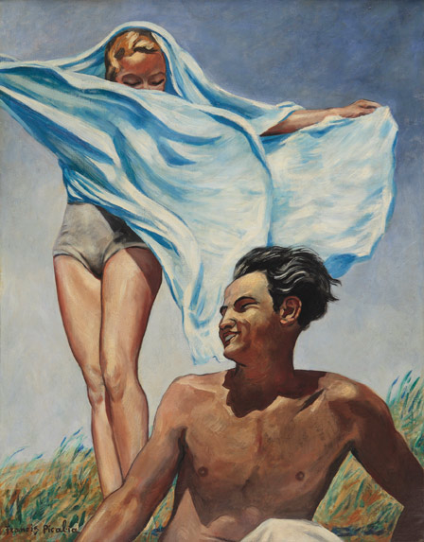
Francis Picabia Printemps 1942–3

Slide 35
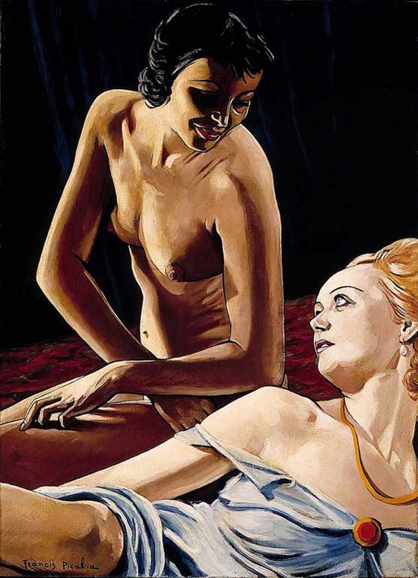
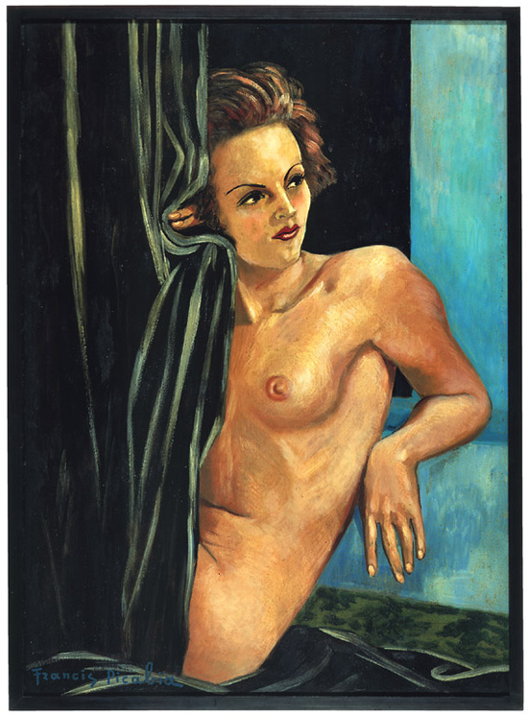
La brune et la blonde 1941-42 Oil on canvas 104 x 75 cm
La femme blonde / La blonde, 1942 Oil on cardboard 106 x 76 cm

Slide 36
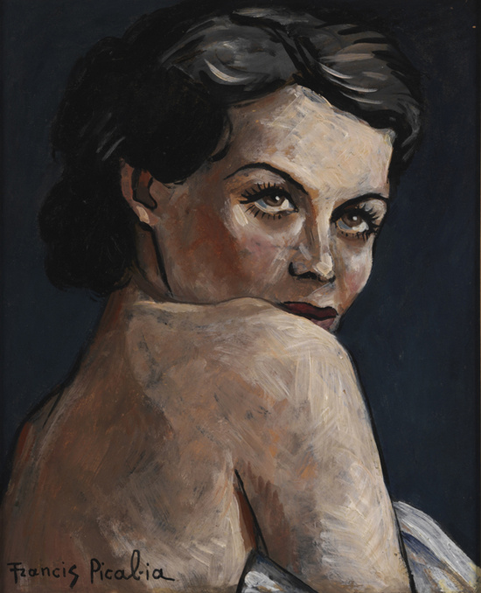
Femme nue 1942 (app.), Oil on canvas, 40.8 x 33 cm

Slide 37
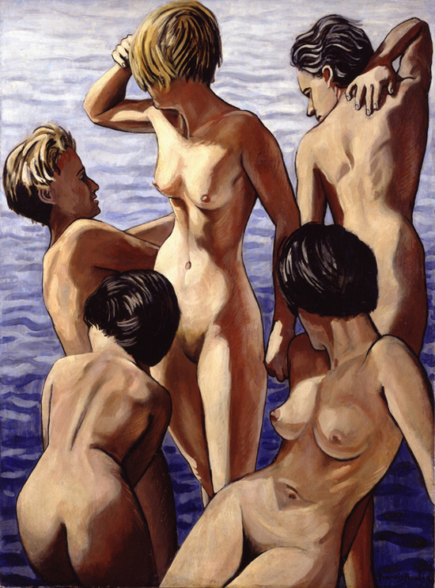
Cinq femmes 1942 (app.) Oil on paper mounted on canvas 101.5 x 75 cm

Slide 38
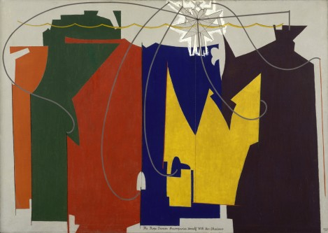
Man Ray,The Rope Dancer Accompanies Herself with Her Shadows, 1916, oil on canvas, 132.1 x 186.4 cm, MoMA, videti na: https://www.moma.org/collection/works/78580

Slide 39
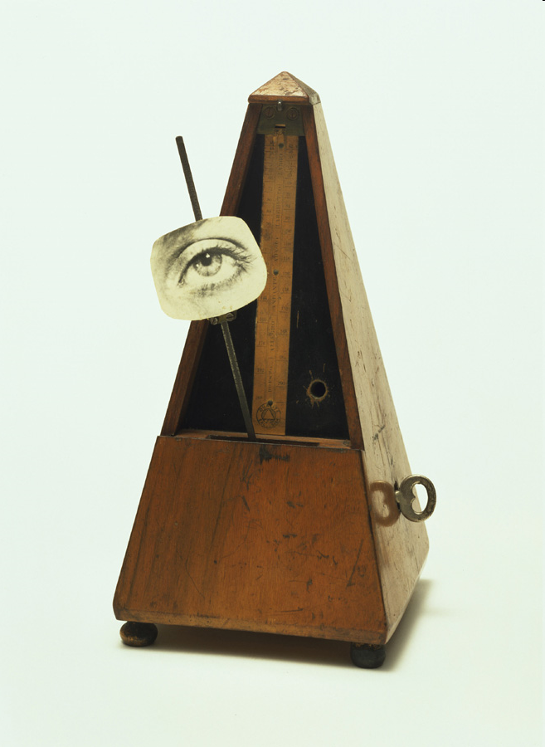
Man Ray, Object to be Destroyed, 1923 (original uništen)
Videti na: https://www.moma.org/learn/moma_learning/man-ray-indestructible-object-1964-replica-of-1923-original/
Ili
https://www.tate.org.uk/art/artworks/man-ray-indestructible-object-t07614

Slide 40
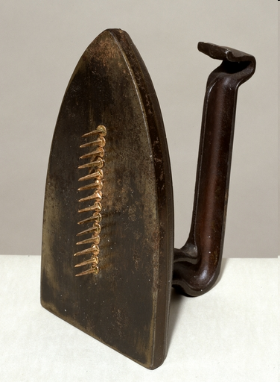
Man Ray, Poklon (Cadeau), 1921
Videti na: https://www.tate.org.uk/art/artworks/man-ray-cadeau-t07883

