Slide 1
institucionalna kritika
(dva talasa: prvi tokom 60ih i 70ih godina 20. veka, drugi od 80ih godina 20. veka)

Slide 2
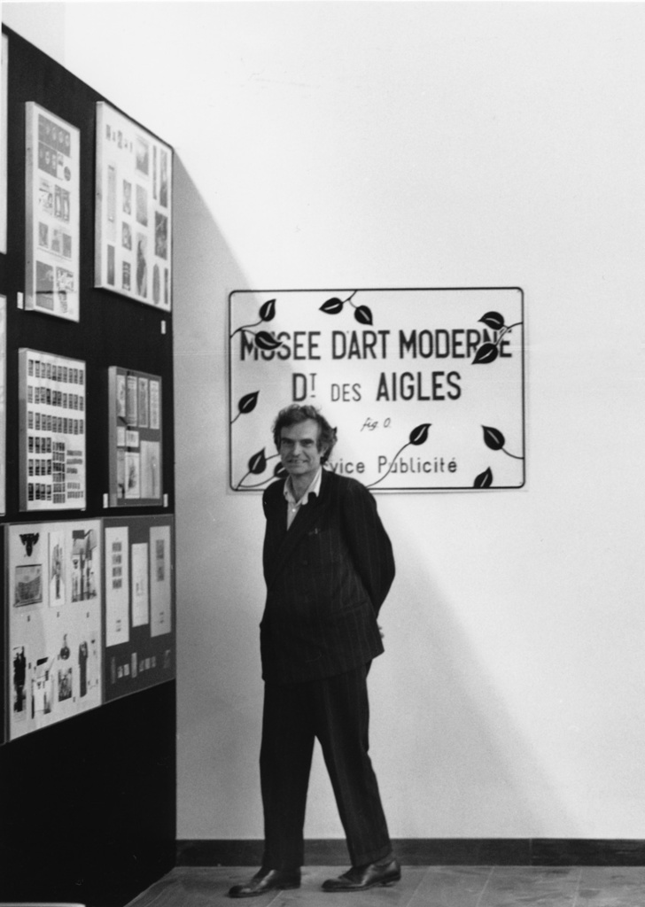
Marcel Broodthaers,
Musée d’Art Moderne, Département des Aigles, 1968-1972 (Muzej moderne umetnosti, Odeljenje orlova)
This Museum is a fictitious museum. It plays the role of, on the one hand, a political parody of art shows, and on the other hand an artistic parody of political events. Which is in fact what official museums and institutions like documenta do. With the difference, however, that a work of fiction allows you to capture reality and at the same time what it conceals.
—Marcel Broodthaers

Slide 3
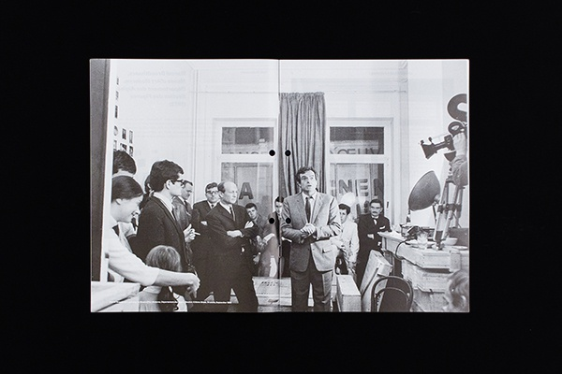
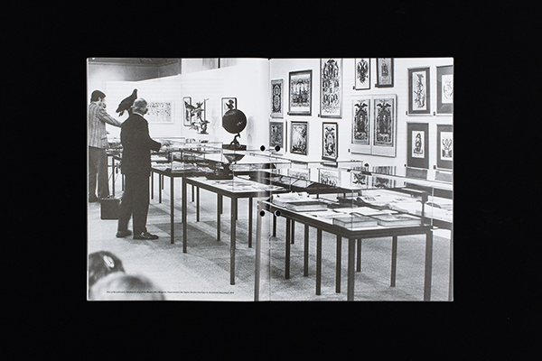
Marcel Broodthaers opening his Musée d’Art Moderne, Département des Aigles, Section XIXème Siècle, Brussels, September 1968
Marcel Broodthaers, installation view of the Musée d’Art Moderne, Département des Aigles, Section des Figures, Der Adler von Oligozän bis heute (The Eagle from the oligocene to the Present) Kunsthalle Düsseldorf, 1972

Slide 4
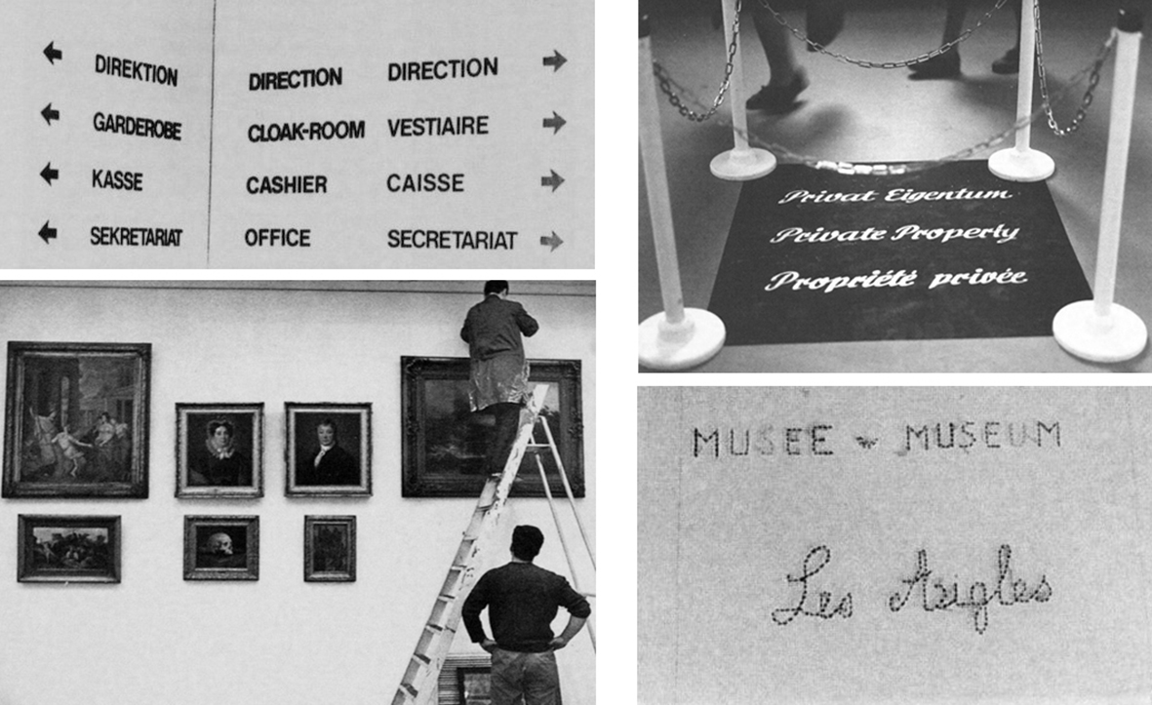

Slide 5
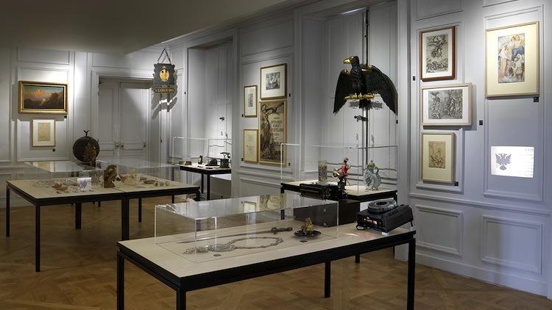
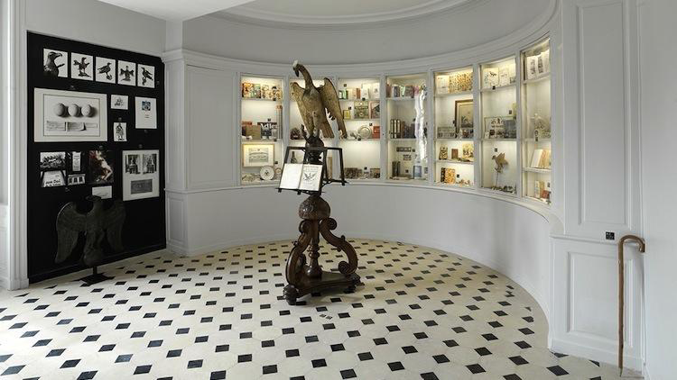

Slide 6
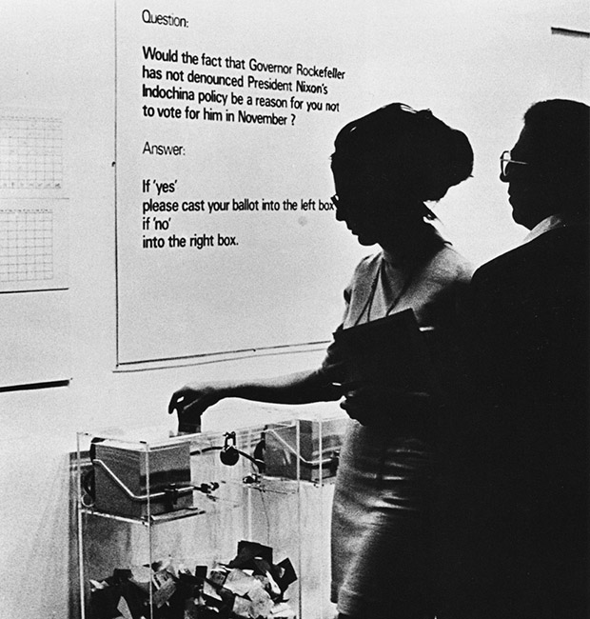
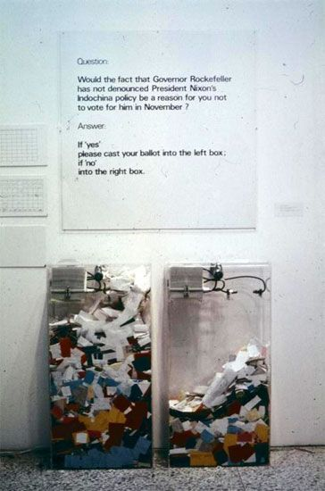
Hans Haacke, MoMA Poll (1970), izložba Information, kustos Kynaston McShine
Videti: https://www.moma.org/magazine/articles/225

Slide 7
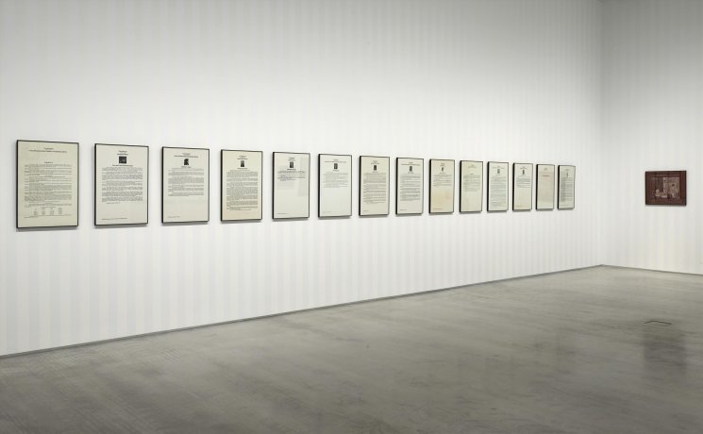
Hans Haacke, Seurat’s "Les Poseuses" (Small Version) 1888-1975
Videti na: https://www.museoreinasofia.es/en/collection/artwork/seurats-poseuses-small-version-1888-1975 i https://www.youtube.com/watch?v=ZojHBmnQcjA

Slide 8
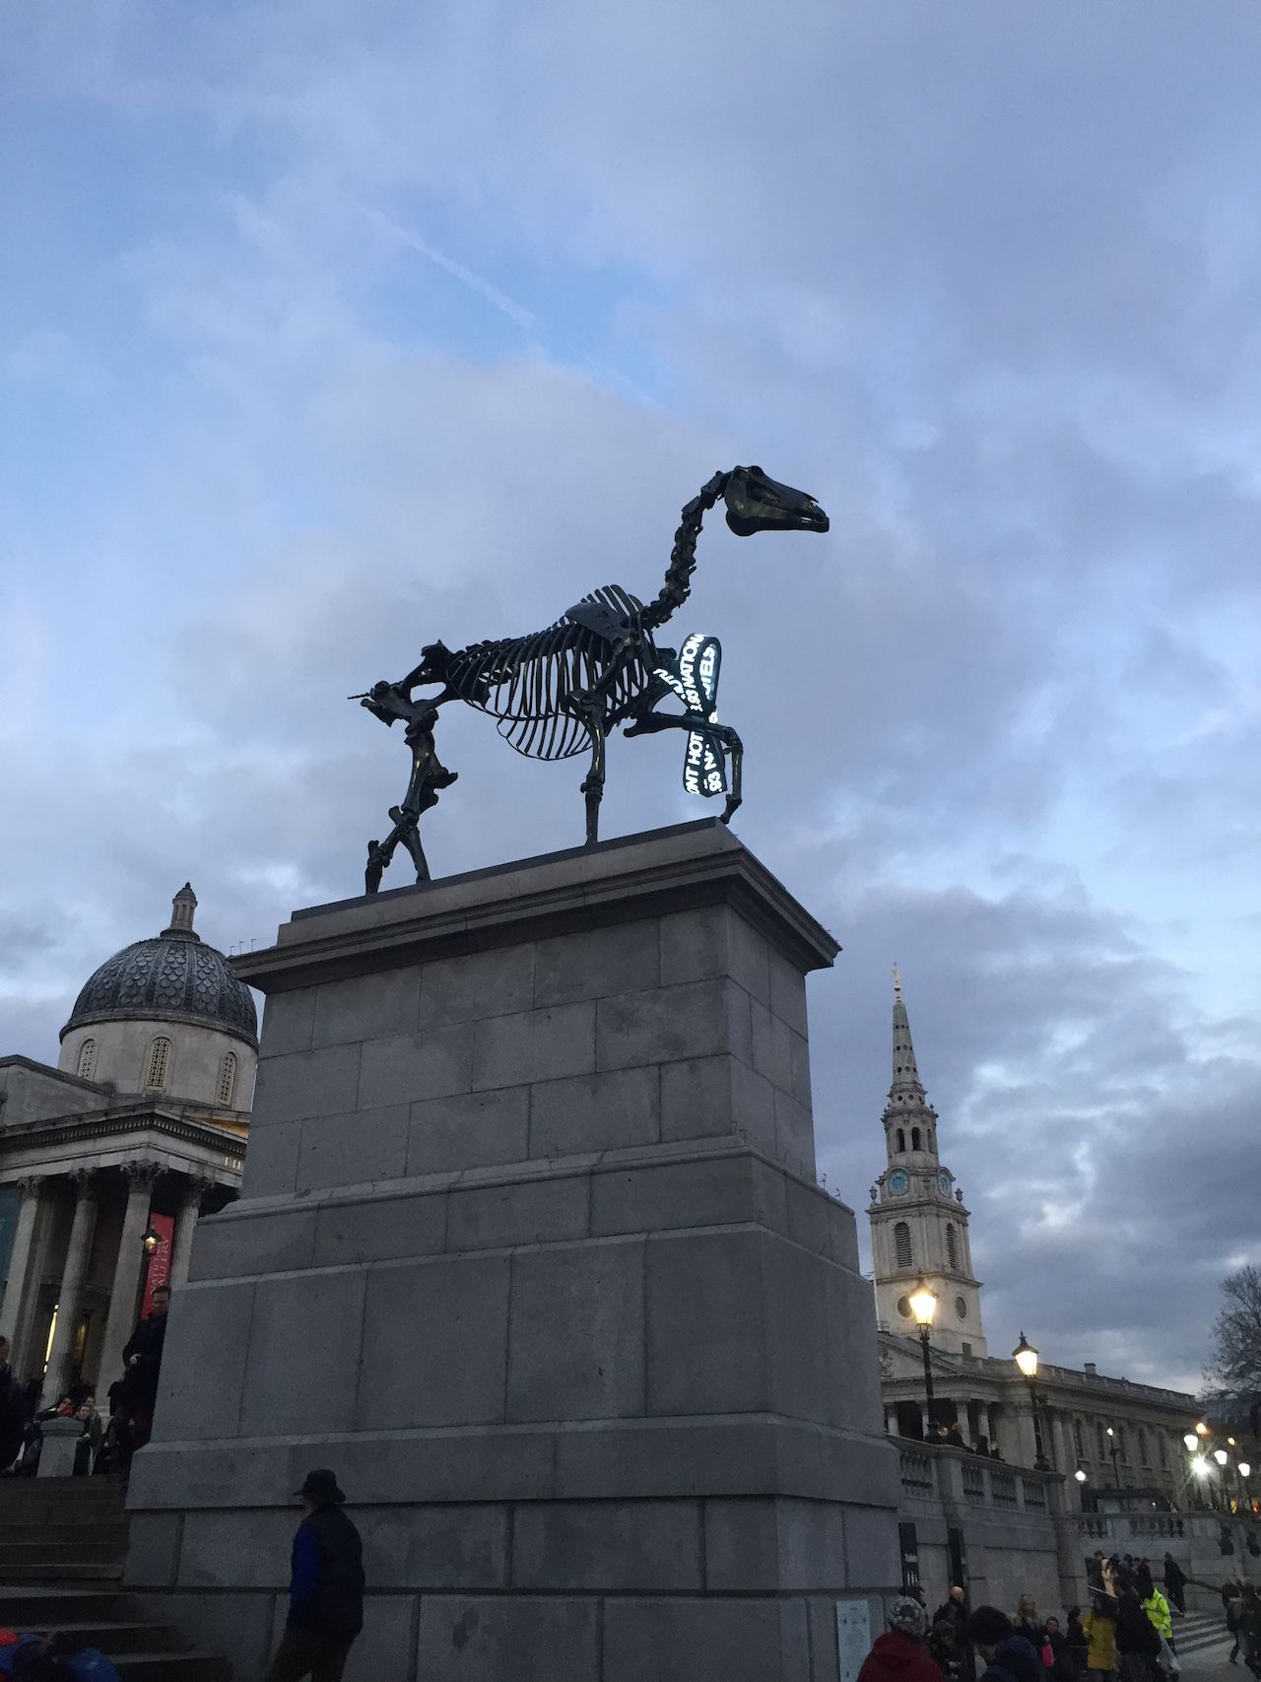
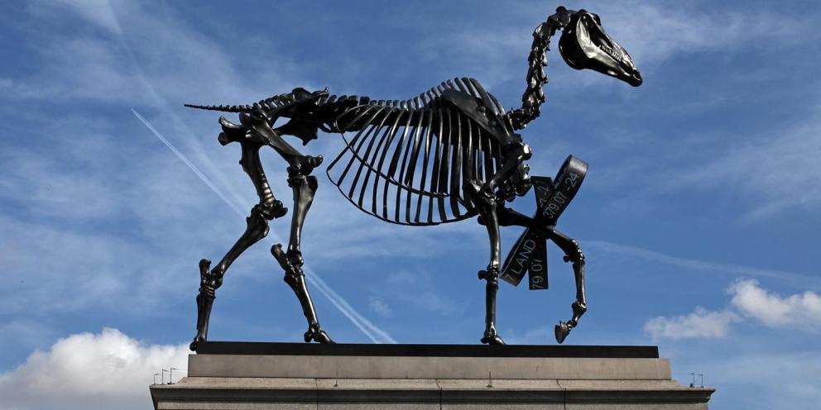
Hans Haacke, Gift Horse, 2014
https://www.youtube.com/watch?v=SqOCZGdsABs i https://www.artic.edu/exhibitions/8944/hans-haacke-gift-horse i
https://www.theguardian.com/artanddesign/2015/mar/05/fourth-plinth-provocative-artwork-gift-horse-hans-haacke-unveiled-in-london i https://www.artnews.com/art-news/news/hans-haacke-boris-johnson-gift-horse-13446/

Slide 9
Robert Smithson, ‘Cultural Confinement’, 1972
Museums, like asylums and jails, have yards and cells – in other words, neutral rooms called galleries. A work of art when placed in a gallery loses its charge, and becomes a portable object or surface disengaged from the outside world. A vacant white room with lights is still a submission to the neutral […] The function of the warden-curator is to separate art from the rest of society. Next comes integration. Once the work of art is totally neutralized, ineffective, abstracted, safe, and politically lobotomized, it is ready to be consumed by society.

Slide 10
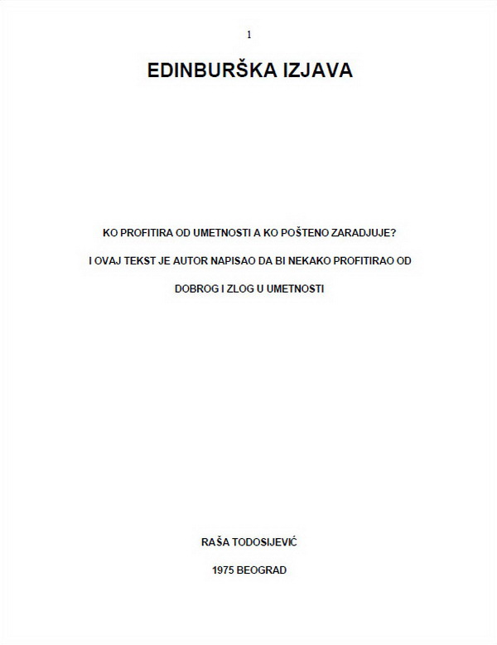

Slide 12
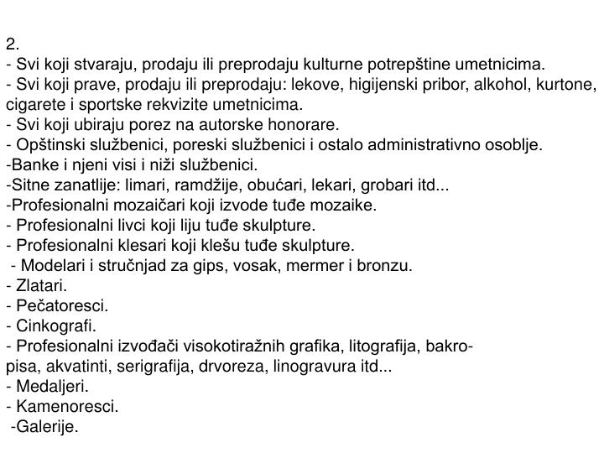

Slide 13
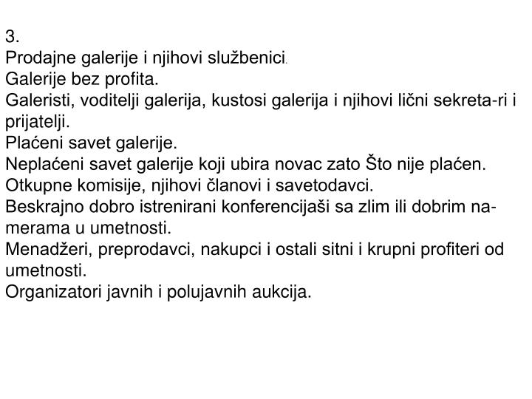

Slide 14
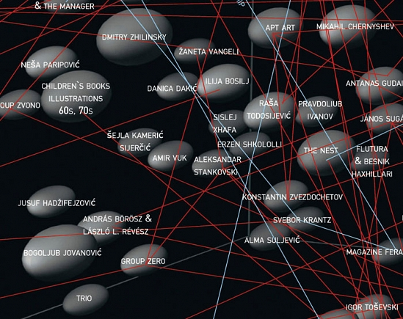
IRWIN, 2001, East Art Map (EAM)

Slide 15
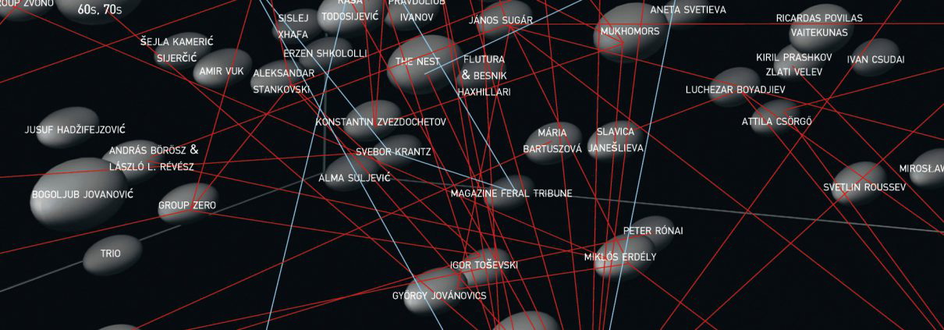
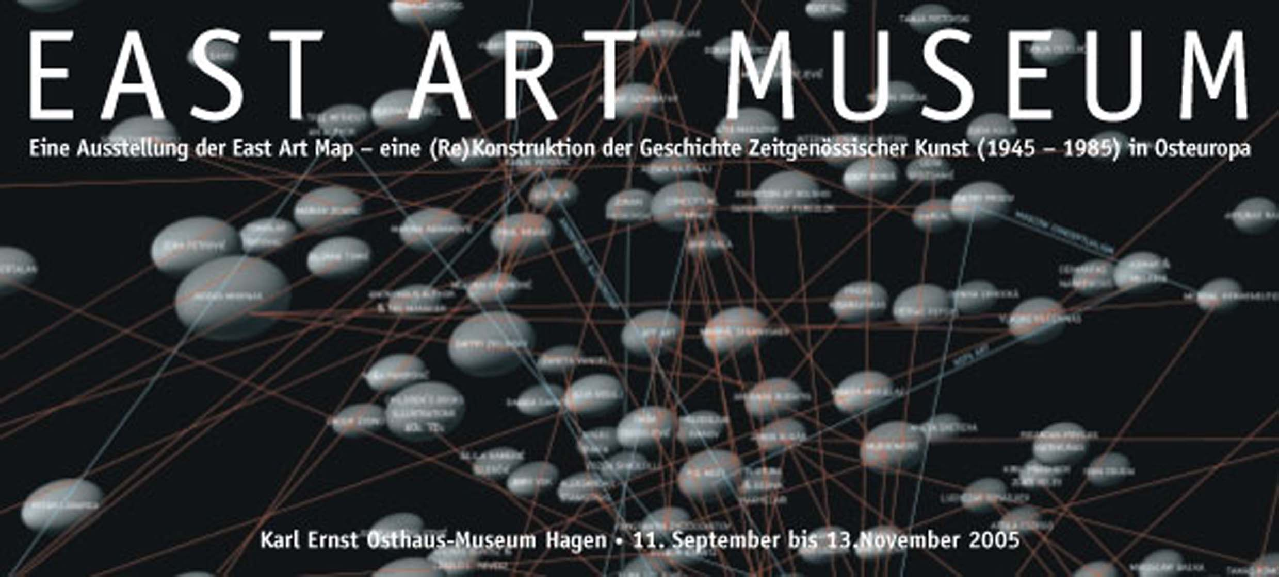

Slide 16
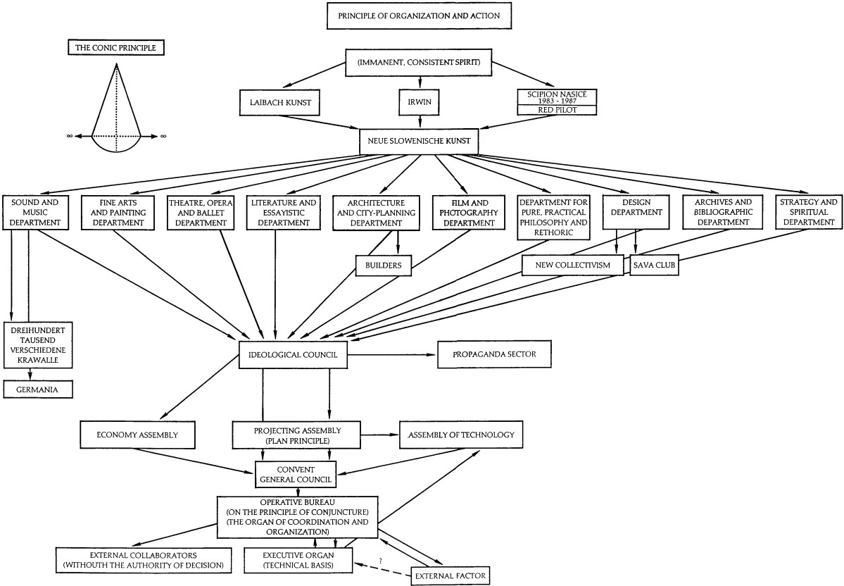

Slide 17
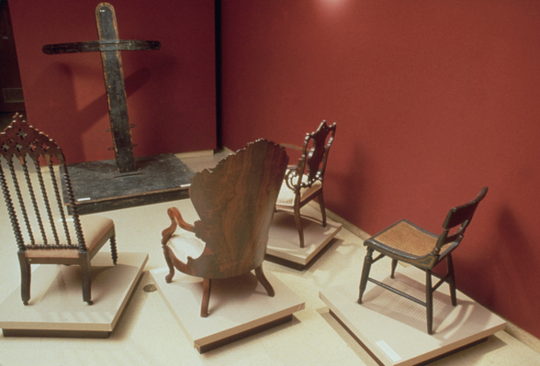
Fred Wilson , Cabinetmaking, 1820–1960, from Mining the Museum, The Contemporary and Maryland Historical Society, Baltimore, 1992–1993. From left: whipping post, date unknown, maker unknown; armchair, c. 1896, maker unknown; side chair with logo of Baltimore Equitable Society, c. 1820–40, maker unknown; armchair, c. 1855, by J.H. Belter; side chair, c. 1840–60, maker unknown.
Videti: http://appartement22.com/spip.php?article419 i https://artcritical.com/2018/07/23/natalie-sandstrom-on-fred-wilson/

Slide 18
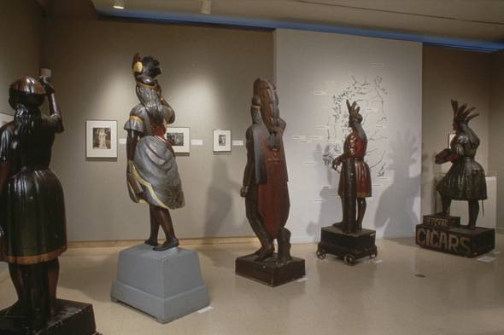
Fred Wilson, Portraits of Cigar Store Owners, from Mining the Museum, The Contemporary and Maryland Historical Society, Baltimore, 1992–1993. Folk sculpture by John Philip Yeager, c. 1870s (except fourth from left: artist unknown)

Slide 19
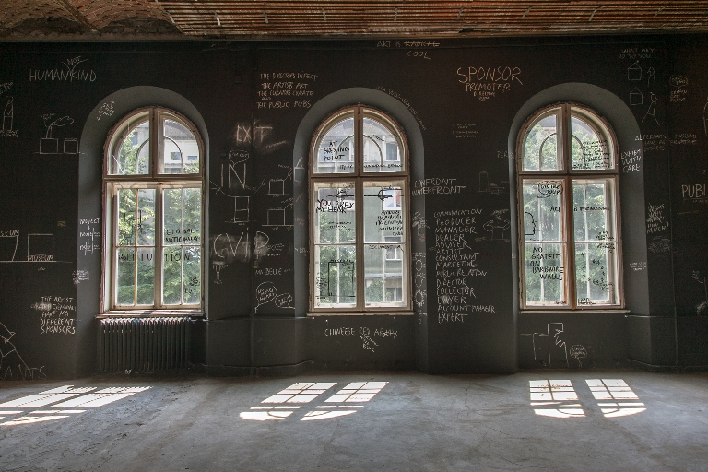
Dan Perjovschi
Videti: https://eng.msub.org.rs/exhibition-upside-down-hosting-the-critique

Slide 20
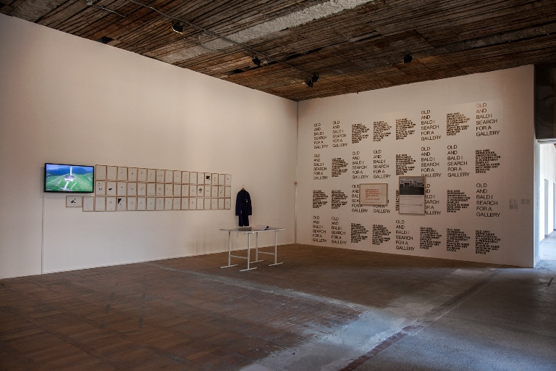
Luchezar Boyadjiev and Goran Trbuljak

Slide 21
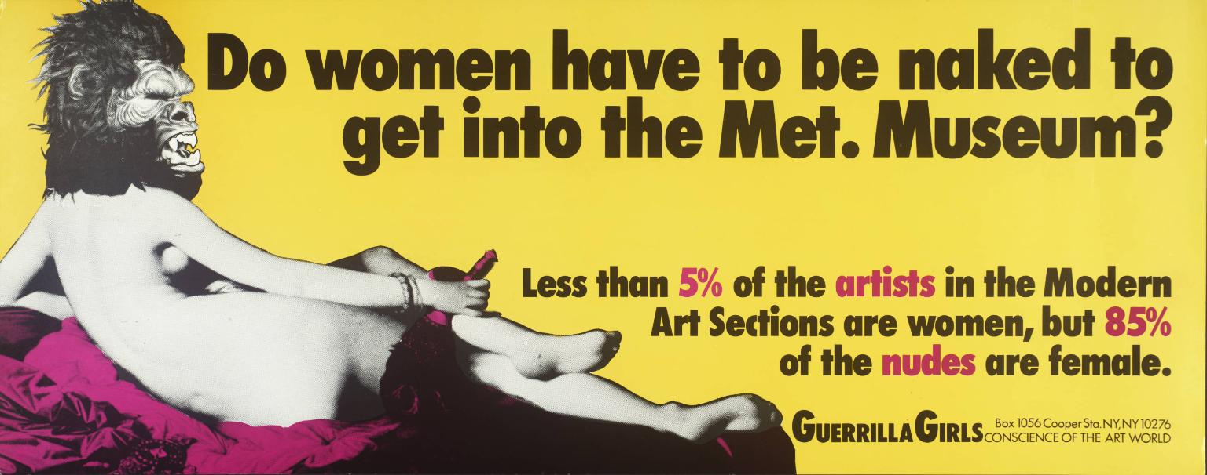
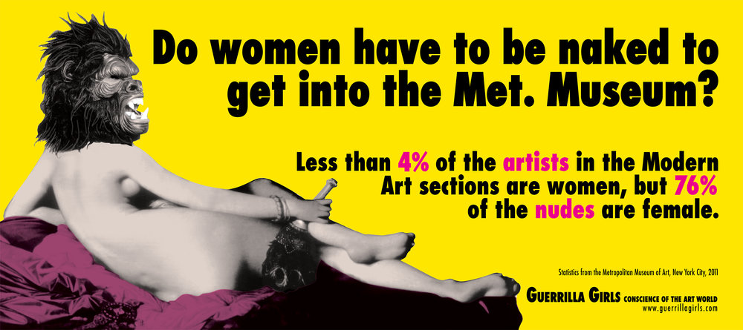
Guerrilla Girls, Do Women Have To Be Naked To Get Into the Met. Museum?
1989 i 2012
https://www.guerrillagirls.com/

Slide 22
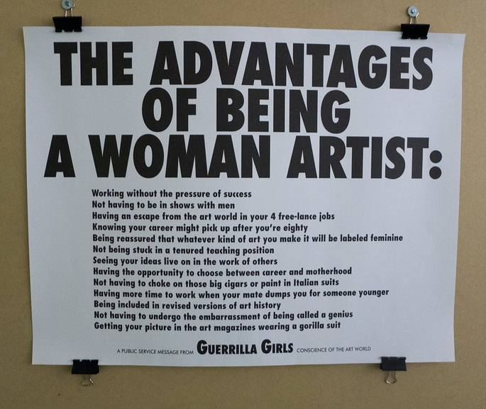
Guerilla Girls – The advantages of being a woman artist, 1988

Slide 23
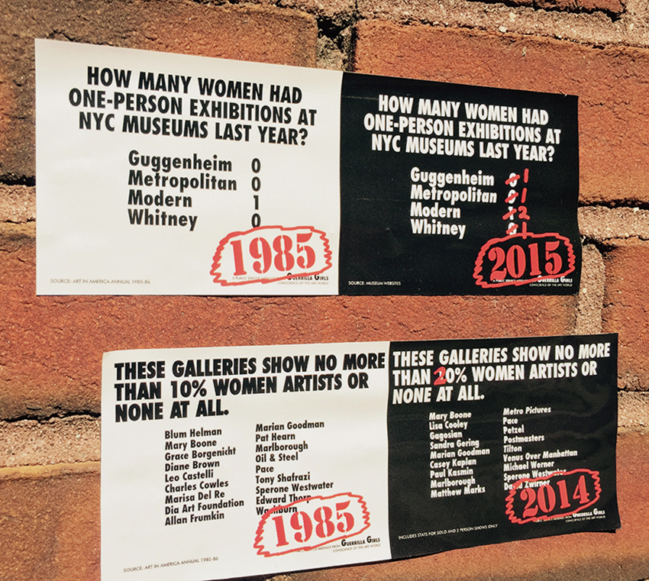
Guerrilla Girls, NYC RECOUNT
2015

Slide 24
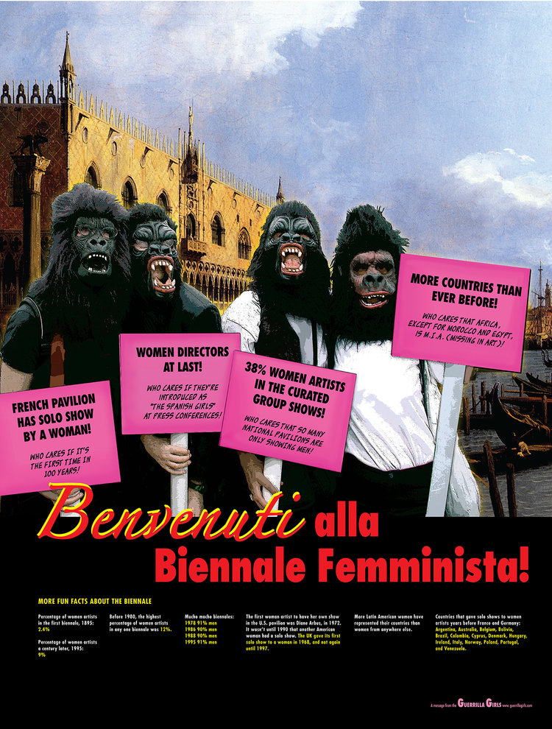
Guerrilla Girls, BENVENUTI ALLA BIENNALE FEMMINISTA!
In this poster, we take on the Biennale itself.
One of six posters shown in the 2005 Venice Biennale “Always a Little Further," curated by Rosa Martinez.

Slide 25
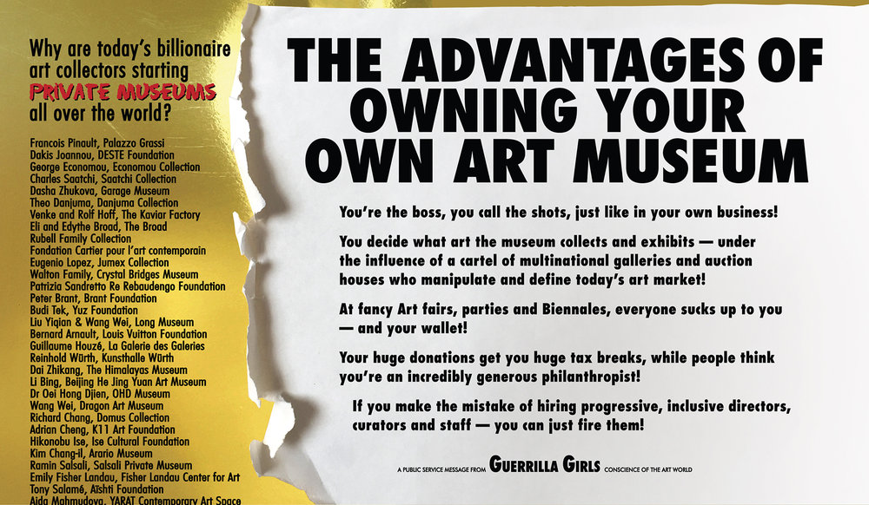
Guerrilla Girls, 2016, ADVANTAGES OF OWNING YOUR OWN ART MUSEUM

Slide 26
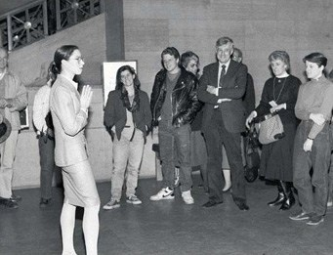
Andrea Fraser, Museum Highlights, A Gallery Talk, for which the artist enacted the role of a museum docent at the Philadelphia Museum of Art, 1989.

Slide 27
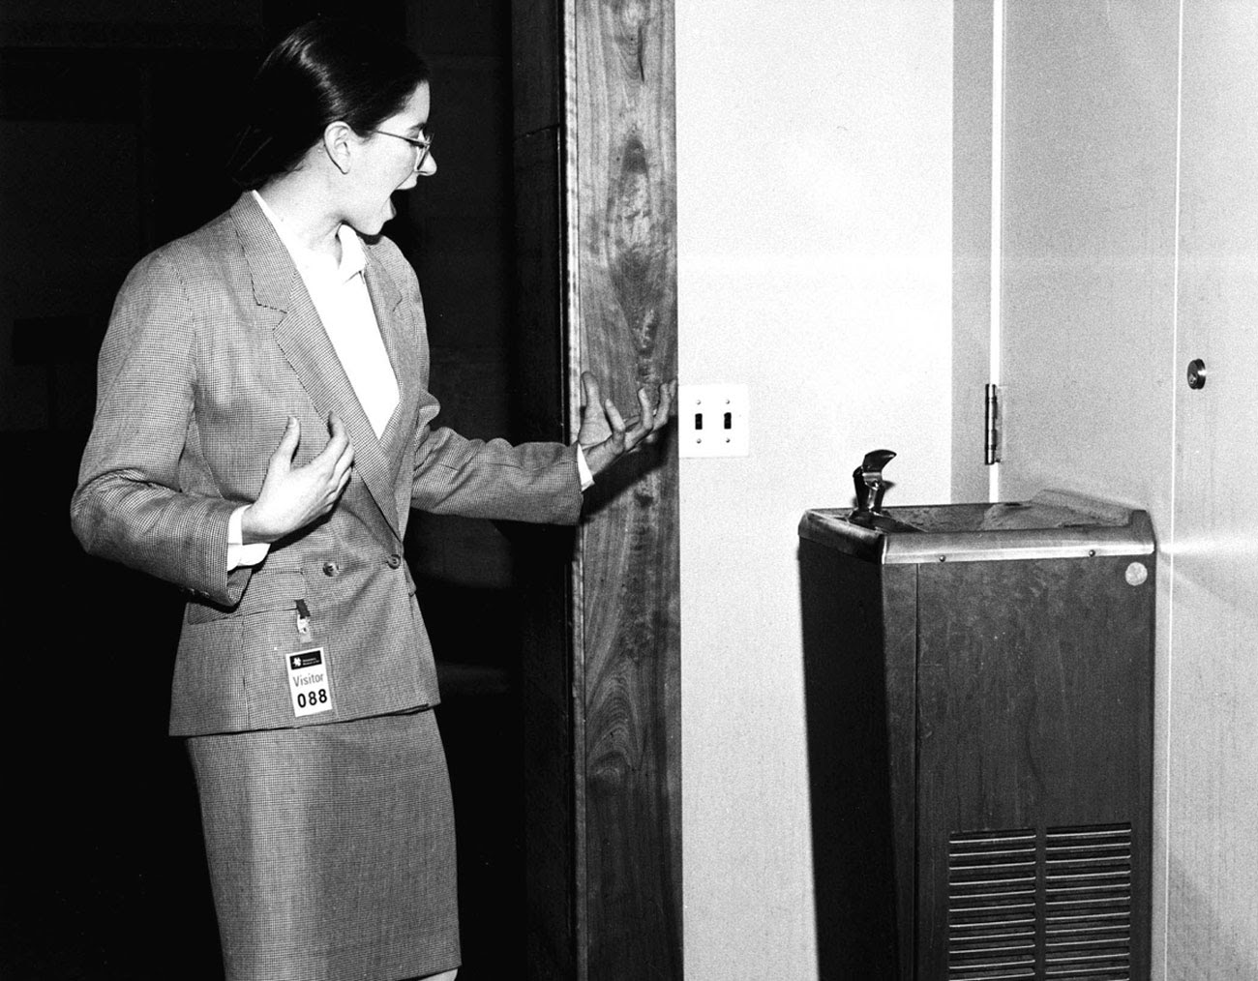

Slide 28
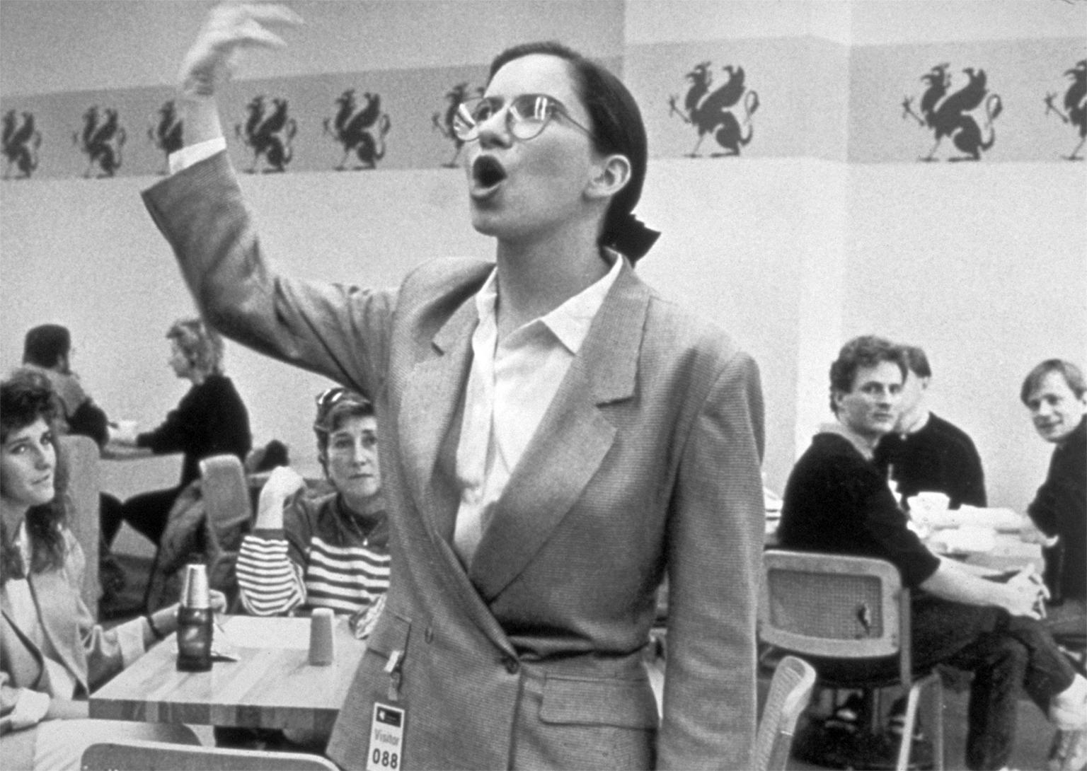

Slide 29
Andrea Fraser: Untitled (2003), Video, 60. min,
https://brooklynrail.org/2004/10/art/andrea-fraser

Slide 30
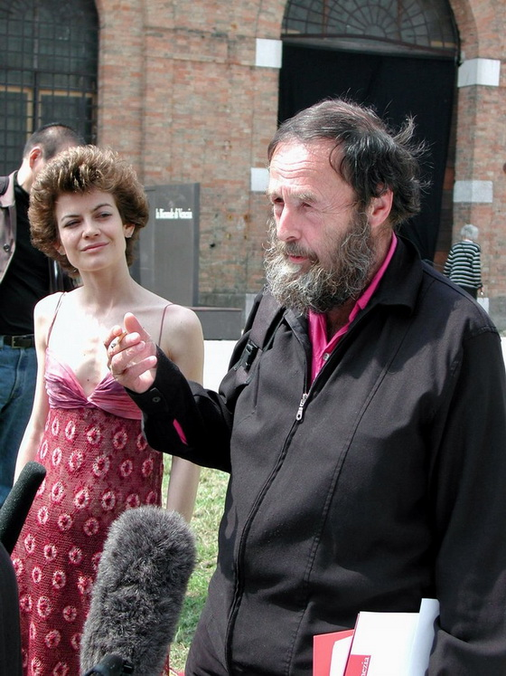
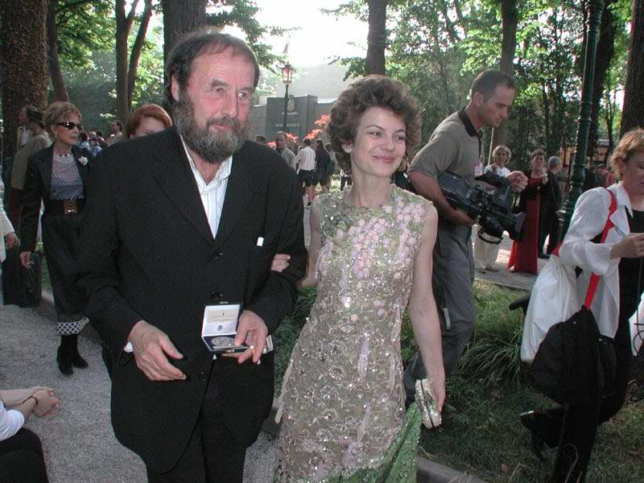
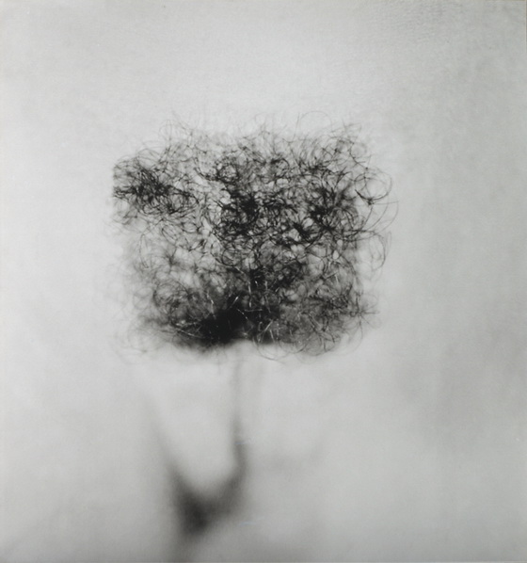
Tanja Ostojić, "Strategies of Success / Curators series", 2001–2003: "I’ll Be Your Angel", 2001. Performance with Harald Szeemann, curator, 49. Biennale, Venice, (1)

Slide 31
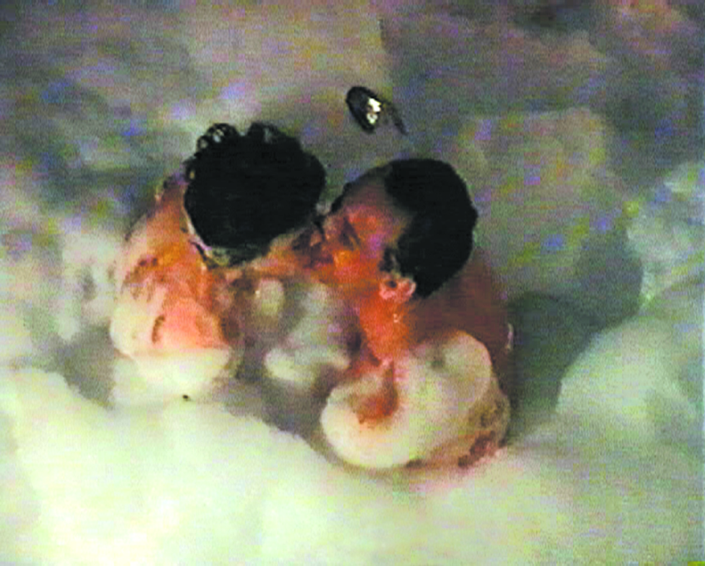
Tanja Ostojić, Be My Guest", 2001. Performance with Bartolomeo Pietromarchi, curator, and Ludovico Pratesi, art critic, "Gravita Zero", Palazzo delle Esposizioni, Rome, (2)
"Sofa for Curator", 2002. (3) Performance with Stevan Vuković, theorist and curator from Belgrade, "Balkan Konsulat", Rotor, Graz, duration: 30min

Slide 32
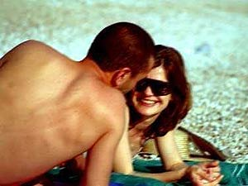
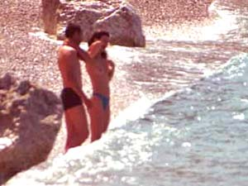
"Vacation with Curator", 2003. Series of paparazzi photographs, photo collages and website with Edi Muka, curator, 2. Biennale, Tirana, Albania, 2003 (4)

Slide 33
Tanja Ostojic. Tanja Ostojic and Marina Grzinic: Politics of Queer Curatorial Positions, 2003 (5)

Slide 34
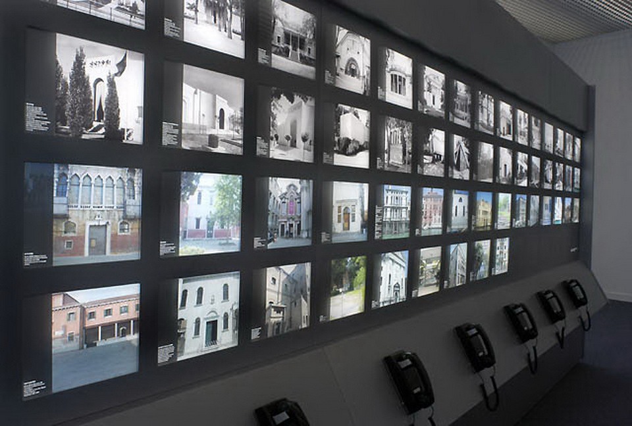
On Translation, Muntadas, 2005

Slide 35
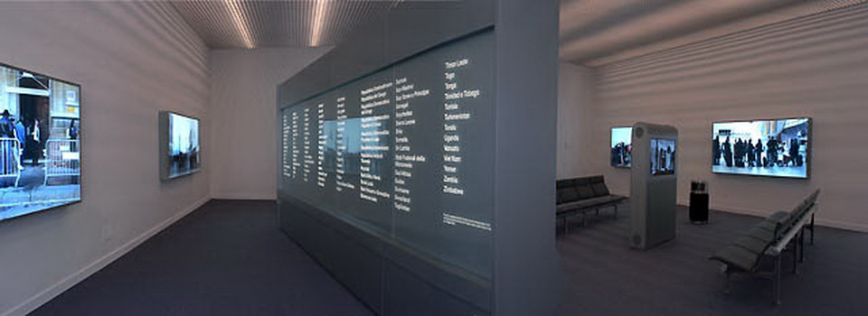
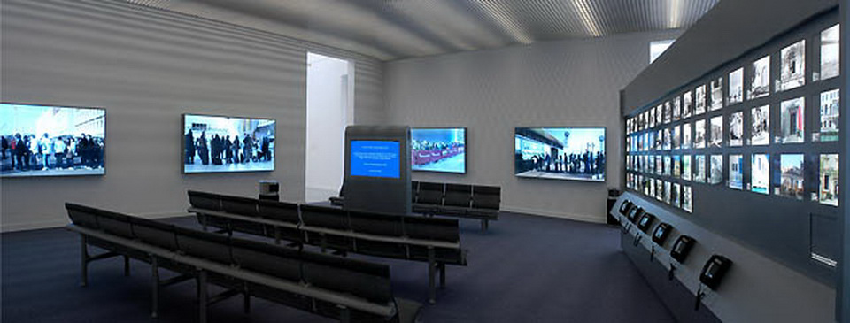

Slide 36
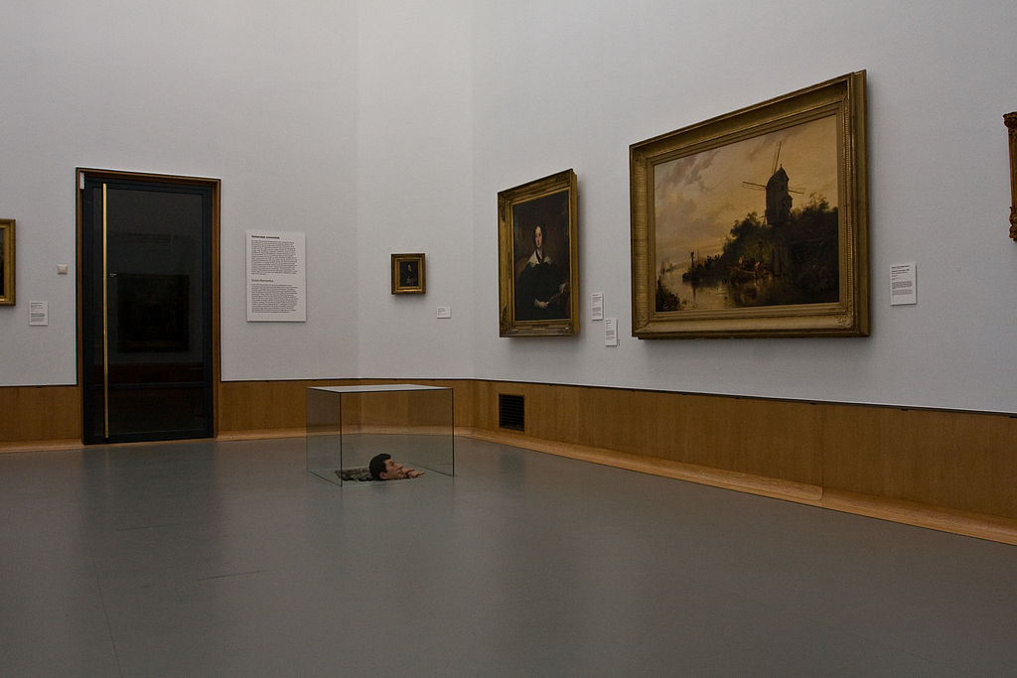
Maurizio Cattelan Untitled, 2001 (2001), Museum Boijmans Van Beuningen

Slide 37
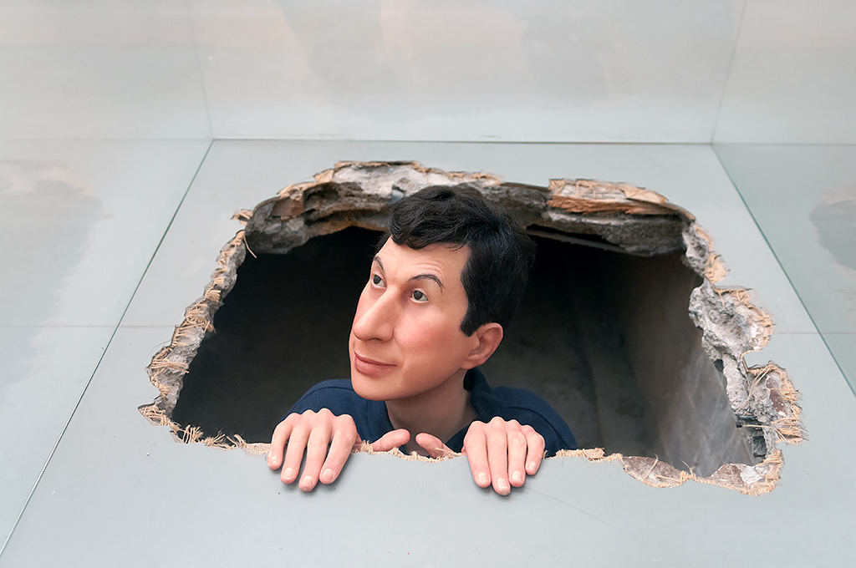
Museum Boijmans Van Beuningen, Rotterdam 2016

Slide 38
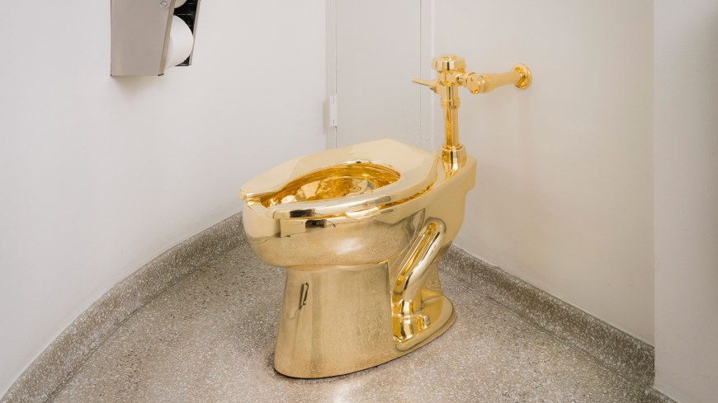
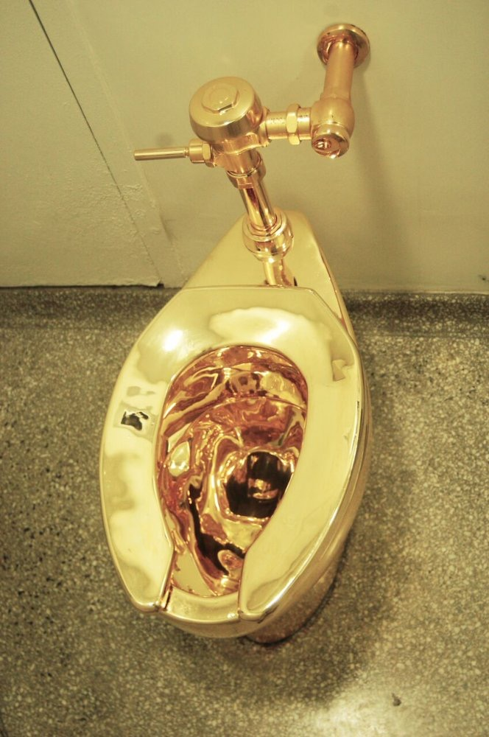
Maurizio Cattelan: “America”, 2016, installation view, Guggenheim Museum, New York.
https://www.studijesavremenosti.org/2019/01/19/trbuhozborac/

Slide 39
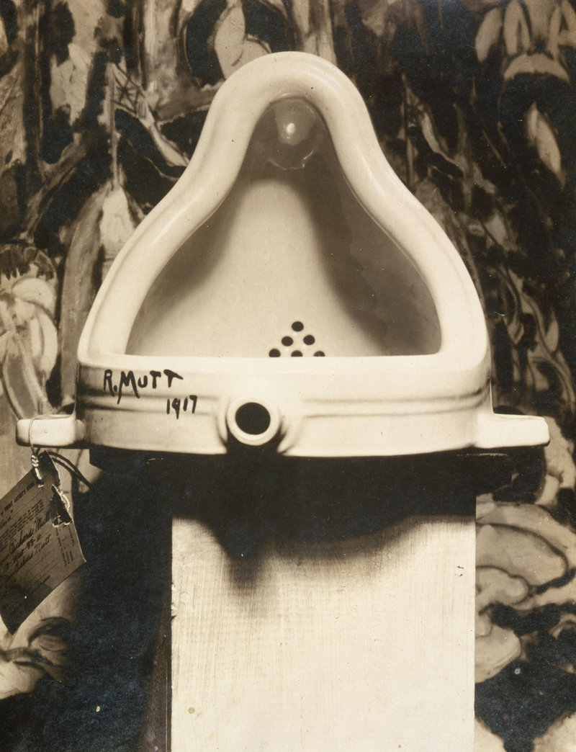
Izložba Society of Independent Artists, 1917

Slide 40
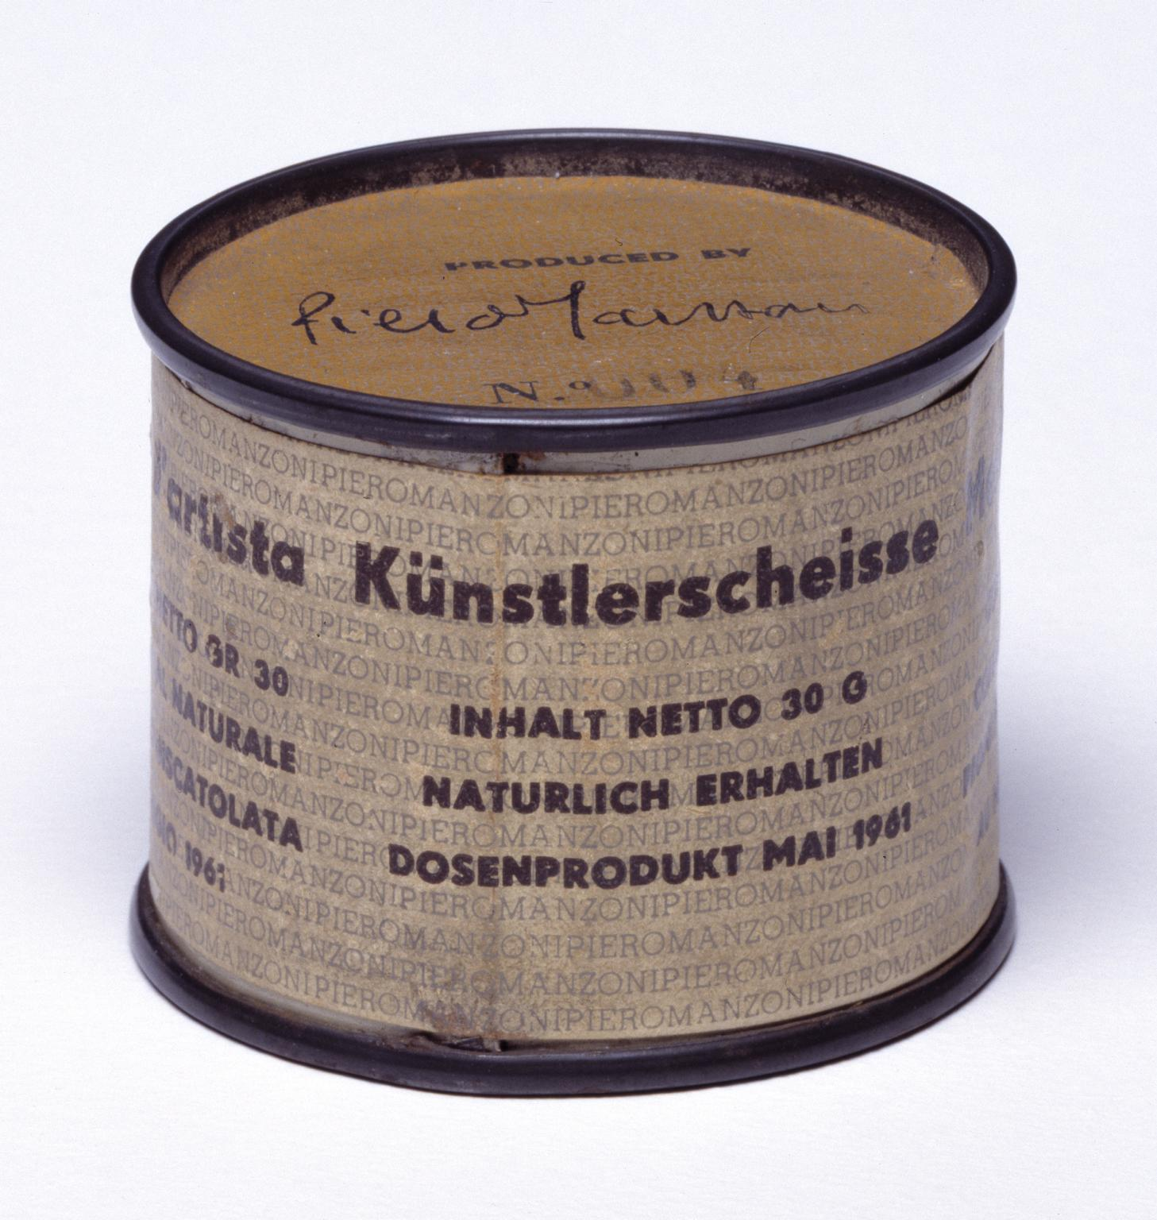
Piero Manzoni,
Merda d'artista, 1961
(001-090)
(23. avgusta1962. sertifikat o prodaji jednog multipla Albertu Luciau za 30 grama 18-karatnog zlata)

Slide 41
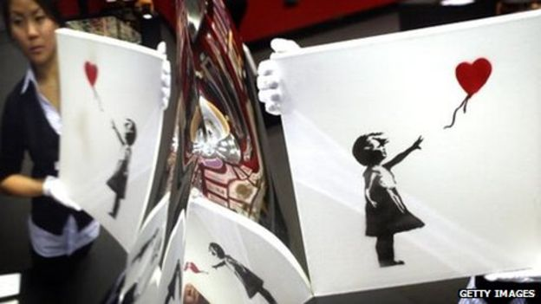
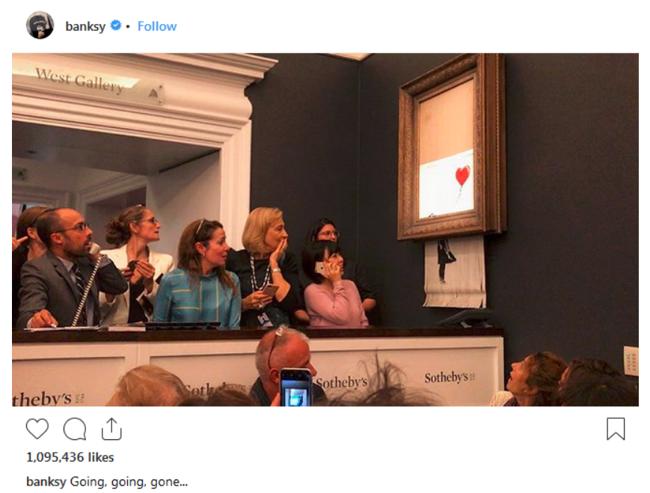
https://www.studijesavremenosti.org/2018/11/11/going-going-gone/

